Slide 1
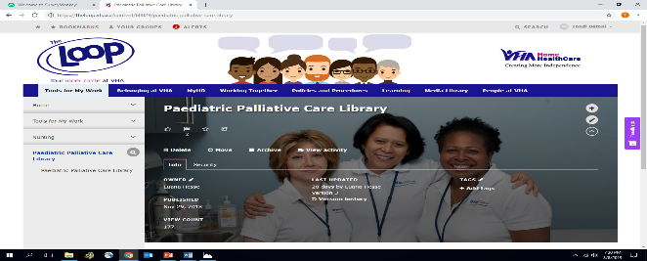
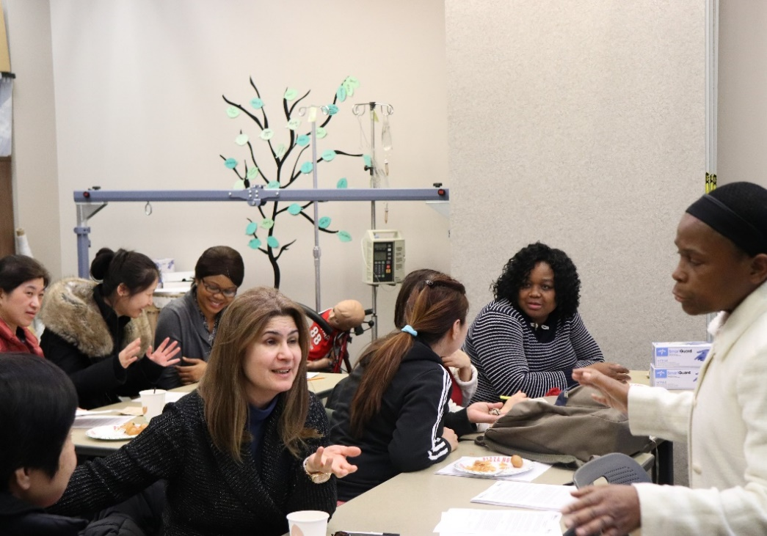
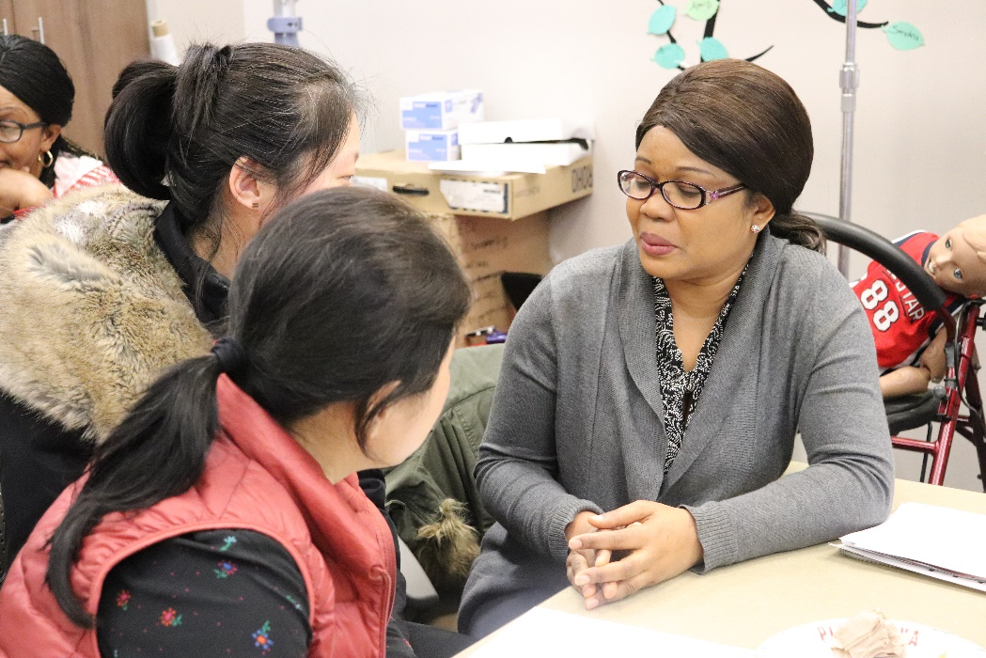
Raising the Bar: Equipping & Supporting Community Paediatric Nurses for the Provision of Quality, Effective, Best Available Palliative & End of Life Care
Tandiwe (Tandi) Betani RN
TAHSNp Innovation Fellowship Program, VHA Home HealthCare & VHA Rehab Solutions, Child & Family Nursing Team
in the PPCL resource
Some CFN stated theyot get the time t view
the PPCL resource yet
k
RESULTS
As of March 8, 2019, there were over 150 views recorded on the PPCL resource on the intranet.
A high number of good reviews from CFNs regarding PPCL, video and “Sharing & Caring” sessions.
FACILITATORS
Worked closely with VHA CFN Supervisors and Regional Client Services Manager, Toronto Central to disseminate information about the project, circulate digital surveys and facilitate “Sharing & Caring”.
Collaborated with Communications department to format/develop PPCL and track number of views; production of session photographs and video of client and family’s perspectives.
The Sick Kids’ “Connected Care” (paediatric home care nursing education & 24 hour phone/on-line support program) pilot project launched at end February, 2019 in Toronto Central has the potential to positively affect CFNs’ knowledge and confidence.
CHALLENGES
Insufficient time available for CFNs to fully go through all the information provided in the PPCL resource
Implementation of all recommendations not possible during time designated for project
NEXT STEPS
Give input regarding development of a Paediatric Palliative Care Digital Learning Tool via the VHA E-Learning Program (iLearn)
RECOMMENDATIONS
Continuation of “Sharing & Caring” during CFN monthly team meetings
Champion development (8-10 champions); production of facilitator guide for “Sharing & Caring” champions & nursing supervisors
Highlights of video of client and family’s perspectives to be incorporated into orientation
BACKGROUND
Paediatric Palliative care aims to improve the quality of life of children (& their families) facing life-threatening illnesses & also certain chronic conditions, through the prevention and relief of suffering; and continues irrespective of whether or not a child receives disease directed treatment.
PRE & POST SURVEY RESULTS
The initial survey results indicated significant gaps in knowledge and confidence level of CFNs.
Nurses self-report of having “moderate knowledge” or being “very knowledgeable” on paediatric palliative care increased from 48.3% (N=60) to 75.8% (N=58) (see Figure 1).
Nurses self-report of having “moderate confidence” or being “very confident” in their ability to provide community based paediatric palliative care increased from 53.3% (N=60) pre to 79.3% (N=58) post (see Figure 2).
Literature search revealed that provision of training/educational information/resources for clinical problem solving, debriefing and peer support is fundamental to nurses being able to provide higher quality, more effective care.^{1,2}
Anonymous e-survey of community paediatric shift nurses identified a gap regarding available literature & specific resources to equip community based nurses to engage clients & family effectively & appropriately.
AIM
The aim of this QI project is for VHA Child and Family Nurses (CFNs) to report an improvement in knowledge of, and confidence in using best available palliative & end of life information by 15 percent by the first week of March, 2019.
INNOVATION
Development of a centralized on-line Pediatric Palliative Care Library (PPCL) on VHA’s Intranet, “The Loop”
Production of video of client and family’s perspectives of what constitutes high quality palliative community paediatric care
Implementation of “Sharing & Caring” (10 minute focused moments) at Child and Family Nursing team meetings
SUSTAINABILITY PLAN
Senior Management to consider facilitating for the development of a digital learning tool using PPCL information via VHA E-Learning Program (iLearn) as a future mandatory module for CFNs
New CFNs to complete e-learning module within first 6 months
Research/Nursing student to be allocated to curate/maintain online PPCL until e-learning tool launch
Integration of highlights from video of client & family perspectives to be considered for CFN Team’s bi-annual education forums
EVALUATION PLAN
Pre-post electronic survey to assess changes in knowledge and confidence (outcome measures)
Qualitative descriptive feedback during “Sharing & Caring” sessions regarding use of PPCL resource and confidence in applying this information to their practice as well as debriefing and accessing peer support
Figure 1
ACKNOWLEDGEMENTS
VHA Research Fellowship Program
“TAHSNp Health Professions Innovation Fellowship Program & Faculty”
VHA Child and Family Nursing Team
Kerry-Ann Smith
Arlinda Ruco
Dr. Sandra Mackay
Dr. Kathryn Nichol
Sandra Tedesco
Ethelyn Pilapil, Oliva Mabborang, Susan Evelyn
Pamela Stoikopoulos, Luana Hesse
Emily and Lindsey Yeskoo
Measure use of centralized PPCL resource through number of clicks or views on the site (process measure)
REFERENCES
1. Nageswaran, S and Golden, S. L.; Improving the Quality of Home Health Care for Children With Medical Complexity: Epub 2017 Apr 24.
2. Morgan, D; Caring for Dying Children: Assessing the Needs of the Pediatric Palliative Care Nurse, PEDIATRIC NURSING/March-April 2009/Vol. 35/No. 2
Figure 2
To learn more about this project please contact tbetani@vha.ca

