Slide 1
Total Pain Documentation in a Palliative Care Community Setting
Presented by
Olivia Logan
  Registered Practical Nurse
  Visiting Palliative Care Team, Scarborough Region
  VHA Home Healthcare
March 22, 2018
Notes:
Hello, my name is Olivia Logan, and I am a visiting palliative care nurse with vha home healthcare in the Scarborough region. VHA home healthcare is a not-for-profit organization that offers 24/7 health care and support services to people of all ages in the comfort of their own home. On the palliative team, where I’ve spent the majority of my practice at VHA, I saw an opportunity for quality improvement within the palliative care nursing charts. This is where the idea of the project of total pain documentation for the palliative care team was realized.

Slide 2
Agenda
Background
Aim
Methods
Process measures
Results
Barriers and Facilitators
Next Steps
Recommendations and Sustainability Plan
Acknowledgements
References
Notes:
Background of the project
The aim that I had set to achieve with the team
The methods used
Process measures
Results
Barriers and Facilitators
Next Steps, Recommendations, and sustainability plan
Acknowledgements
References

Slide 3
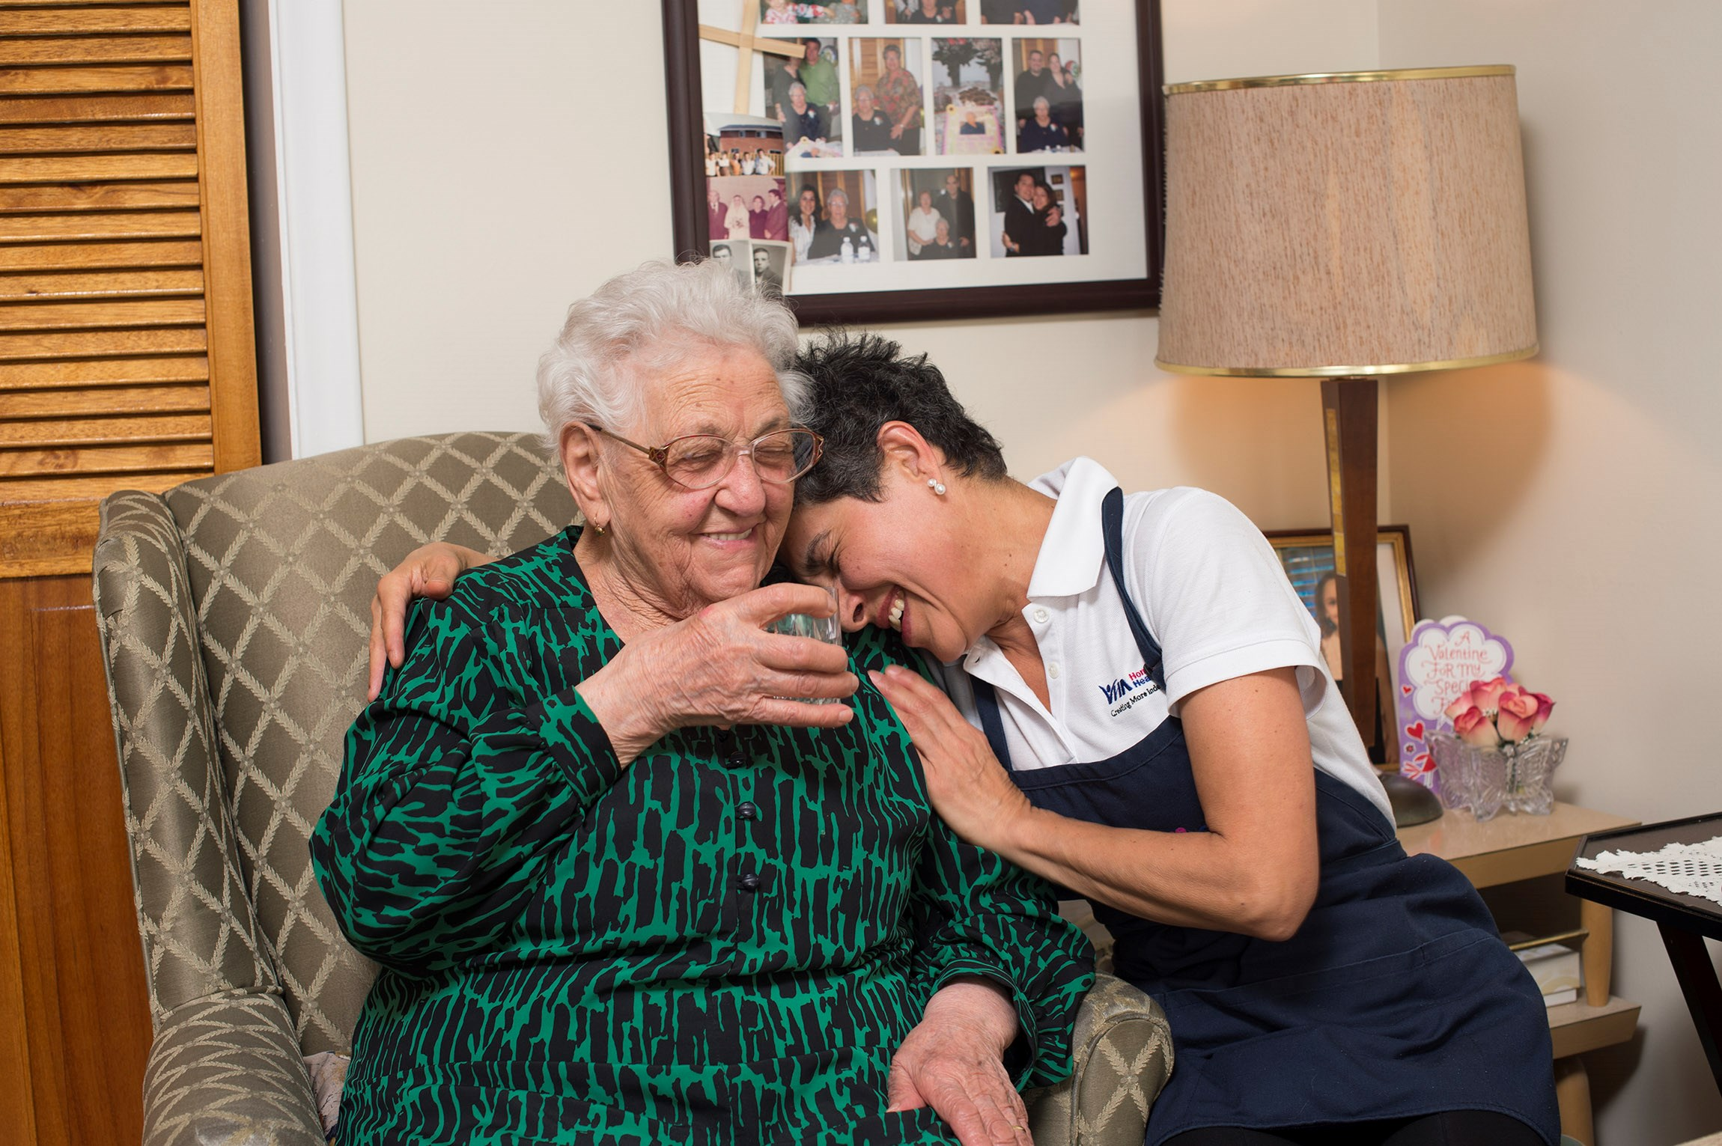
Background
Palliative care nurses strive to attain exceptional skills at pain and symptom management consultation
Pain Assessment Tool, and Palliative Assessment Tool available to use in the nursing chart
Combine the use of both forms to use as a guide through the 8 domains of total pain to complete the total pain assessment
Notes:
Community palliative care nurses strive to attain exceptional pain and symptom management skills to capture quality client-centered care. In order to capture this in a concise and consistent format, it is strongly recommended to combine the use of the pain and palliative assessment tools, which are conveniently located in the palliative care nursing chart. These 2 tools used combined will allow the nurse to explore all 8 domains of total pain during the nursing pain assessment.

Slide 4
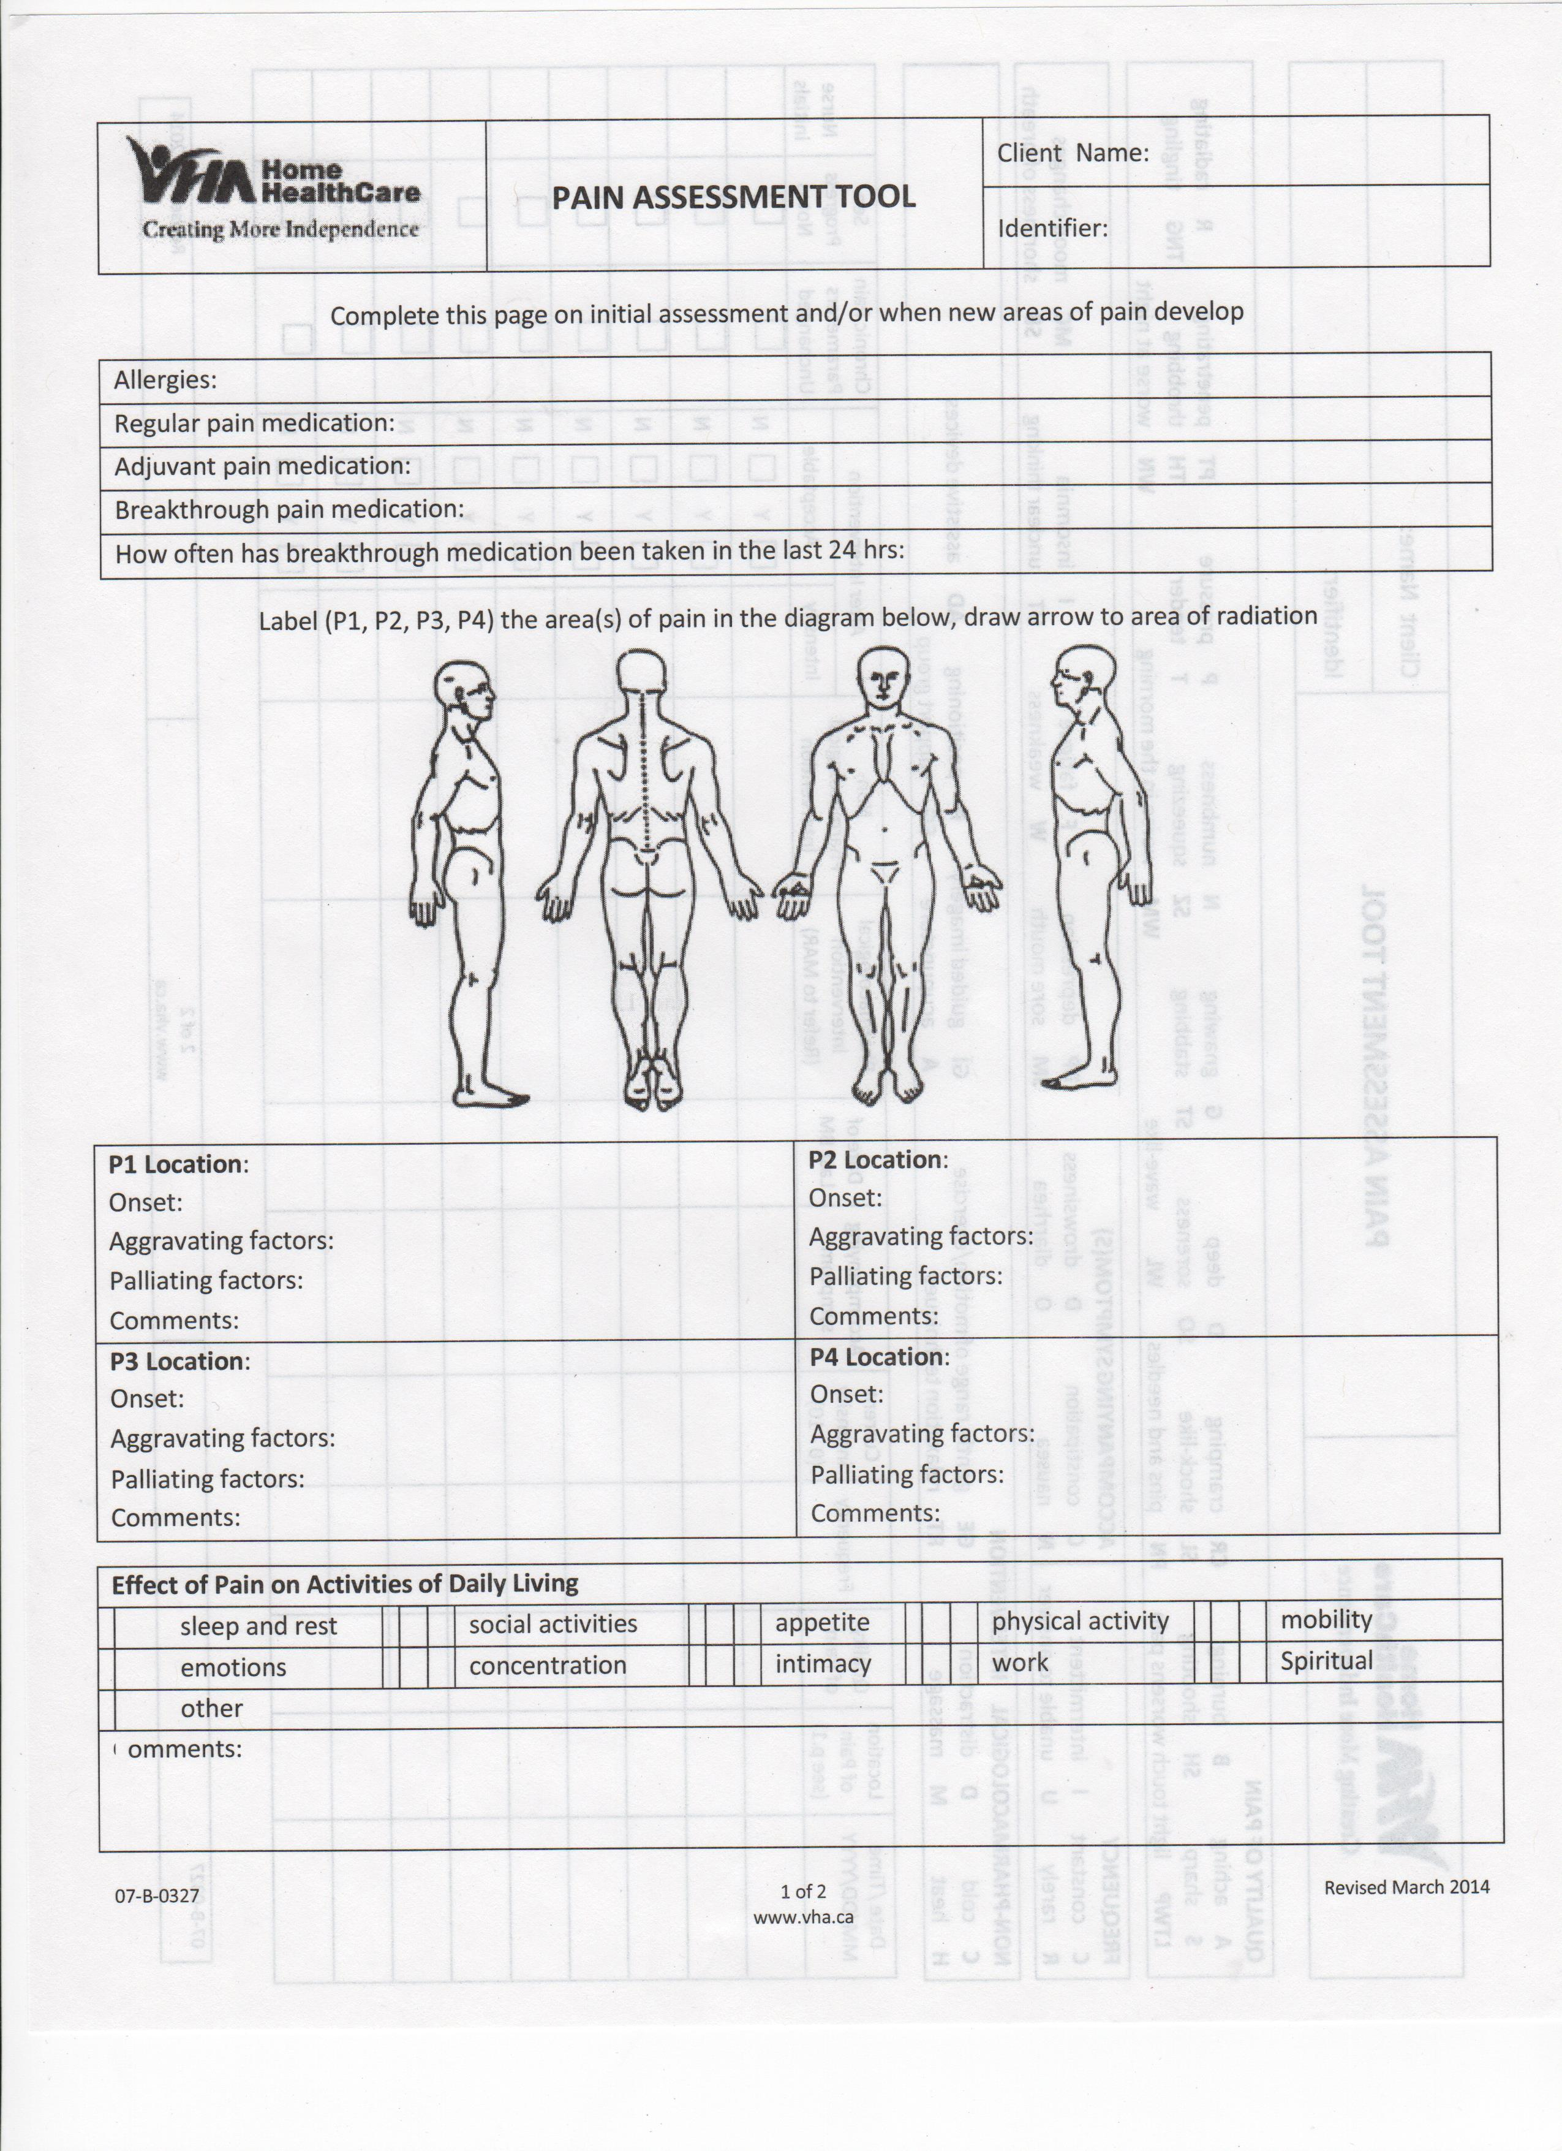
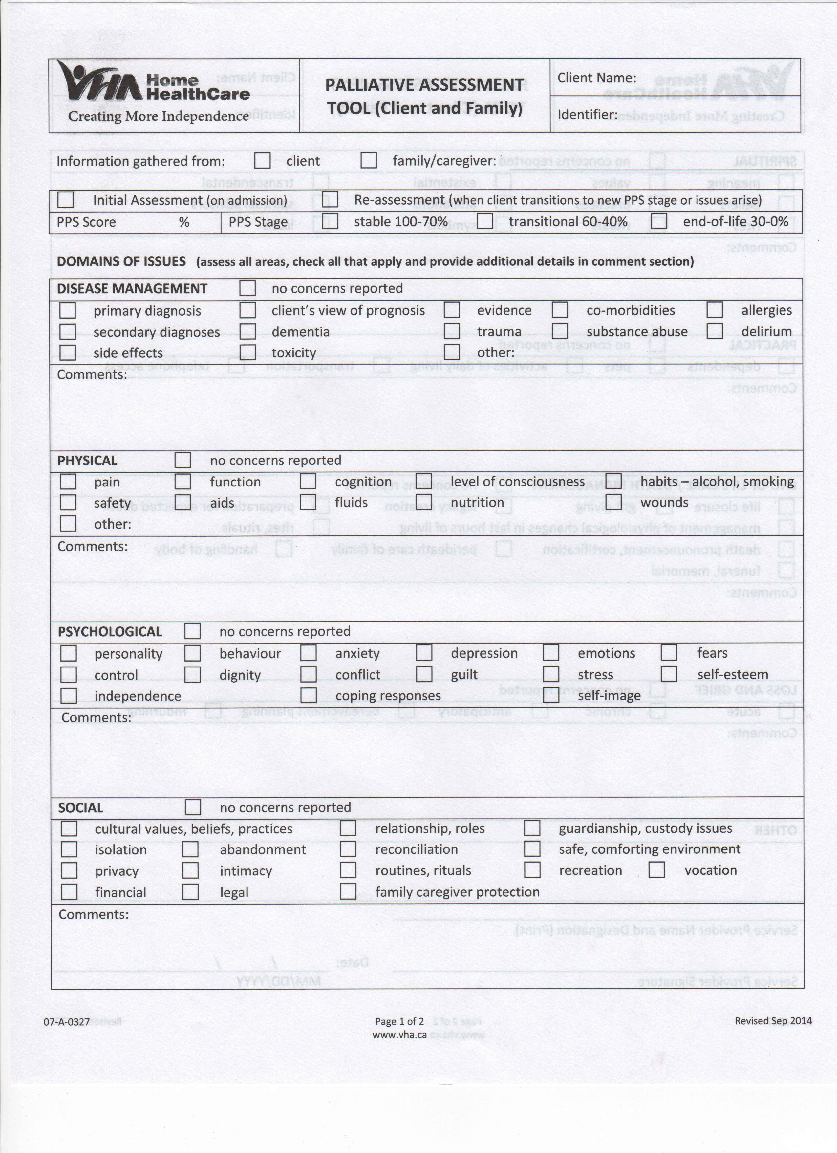
Notes:
These are the current pain tools found in the nursing chart. The Pain Assessment Tool focuses primarily on physical pain, while the Palliative Assessment Tool is a more comprehensive tool of the other components involved in total pain, such as social, and psychological pain.

Slide 5
The 8 Domains of Total Pain
Disease management
Physical
Psychological
Practical
Spiritual
Social
Loss and grief
End of life
Notes:
These are all 8 domains of the total pain assessment. By completing both of these pain tools, the nurse is able to deepen their understanding of what is most important to the client in their perspective, and adjust their care plan accordingly.

Slide 6
Needs Assessment
Chart audit
Analyzed 20 palliative care nursing charts
Communication strategies
Phone calls
Emails
Text messages
Utilization of pain tools:
Pain assessment tool 15%
Palliative assessment tool 10%
One-on-one interviews
Notes:
Next, I was able to determine the depth of education and frequency of communication reminders strategies required to increase the awareness and utilization of the pain tools by analyzing the chart audit data. The results demonstrated that there was little awareness of the palliative assessment tool, and there was some acknowledgement to use the pain assessment tool. The communication strategies used to gather the nurses feedback was done by one-on-one interviews, phone calls, emails, and text messaging.

Slide 7
In other words…
Percentage of Pain and Palliative Assessment Tools Used in 20 Randomly Selected Palliative Care Charts Versus Total Pain Assessment Captured in Progress Notes
Notes:
So in other words, I’m hearing that the nursing staff are conducting total pain assessments, however this information appears to be captured in various places, in a inconsistent format. Some total pain components such as social and psychological pain, were often documented in the progress notes rather than the palliative assessment tool.

Slide 8
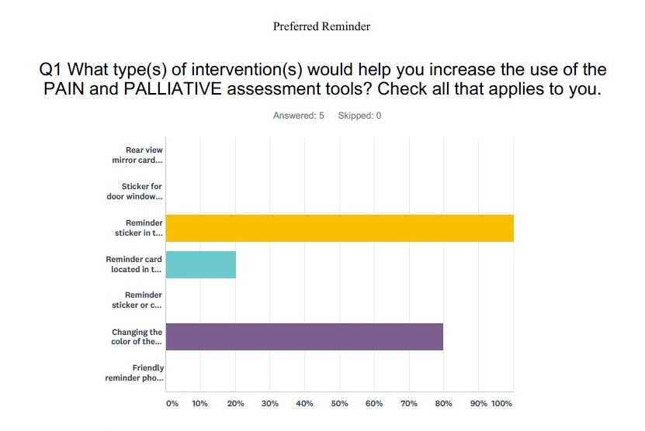
Notes:
Now that I’ve listened to how these nurses conduct their assessments, I realize there’s a need to educate and remind these individuals to search for the palliative assessment tool. I’ve created an anonymous survey with reminder strategies from an evidence-based literature review. There, I was able to see what method the staff would prefer to use the most. I received 5 responses out of 12 staff.

Slide 9
Aim
To improve the quality of total pain documentation by adhering to the completion of the pain and palliative assessment tools 15% by March 2018
Duration of evaluation
Notes:
Knowing this, I created an aim:
To improve the quality of total pain documentation by adhering to the completion of the pain and palliative assessment tools 15% by march 2018.

Slide 10
Implementation Strategies
Educational Video
Review difference between pain and total pain
Colored Assessment Forms
Changed the paper color from white to pink
Reminder Stickers
Bright neon reminder stickers in the chart to complete tools
Communication Strategies
Relevant to practice environment
Under 10 minutes
Increase awareness of the tool
2 PDSA cycles for most effective reminder location
12 phone call interviews within a 2 week period between 8 nursing staff
2 emails / week for 2 weeks sent to team inbox
Text message sent to nursing team twice weekly for 1 week
Notes:
There was a variety of implementation strategies used to increase the completion of the pain and palliative assessment tools. I created an educational video where the palliative focused education is delivered under 10 minutes, changed the color of the forms from white to pink to increase the visibility and awareness, placed bright neon reminder stickers within the chart, and I used a variety of communication strategies during the implementation phase to follow up with the ongoing use of the total pain assessment tools.

Slide 11
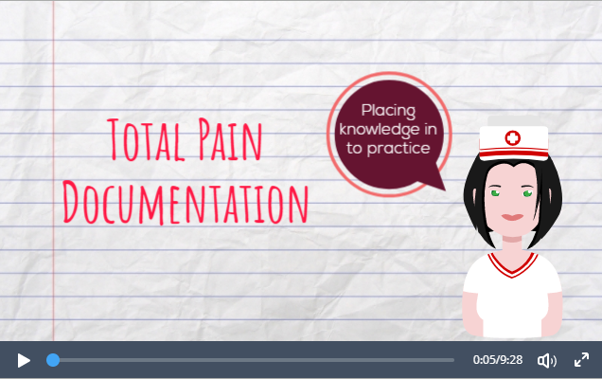
Method #1
Educational Video
Explains difference between pain and total pain
Guides how to use the palliative assessment tool effectively
Under 10 minutes
iLearn, VHA’s online learning platform
Notes:
The educational video explains the differences between pain and total pain, guides how to use the palliative assessment tool effectively, the content was delivered under 10 minutes, and it was posted on VHA’s online learning platform, iLearn, to facilitate tracking for analysis purposes.

Slide 12
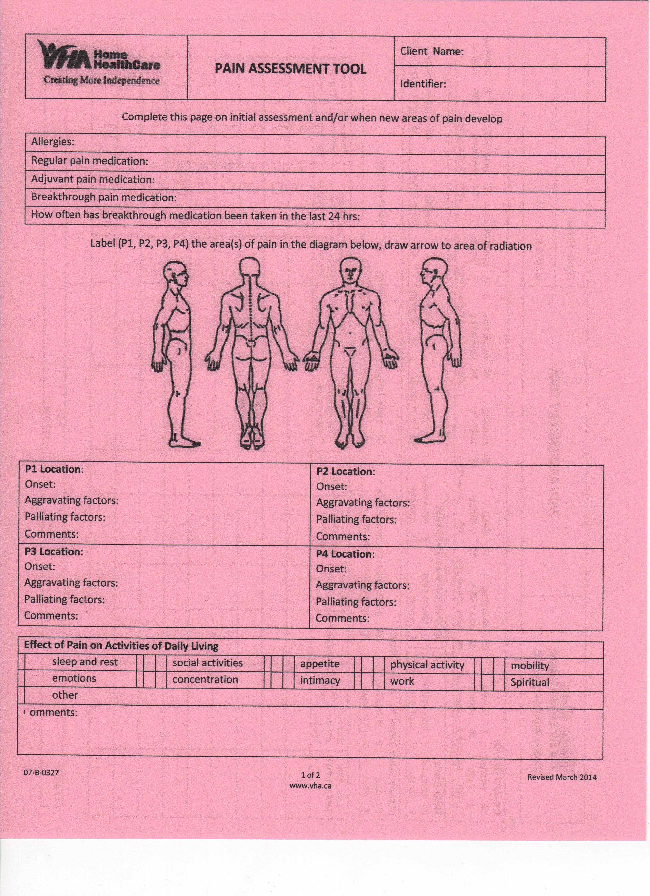
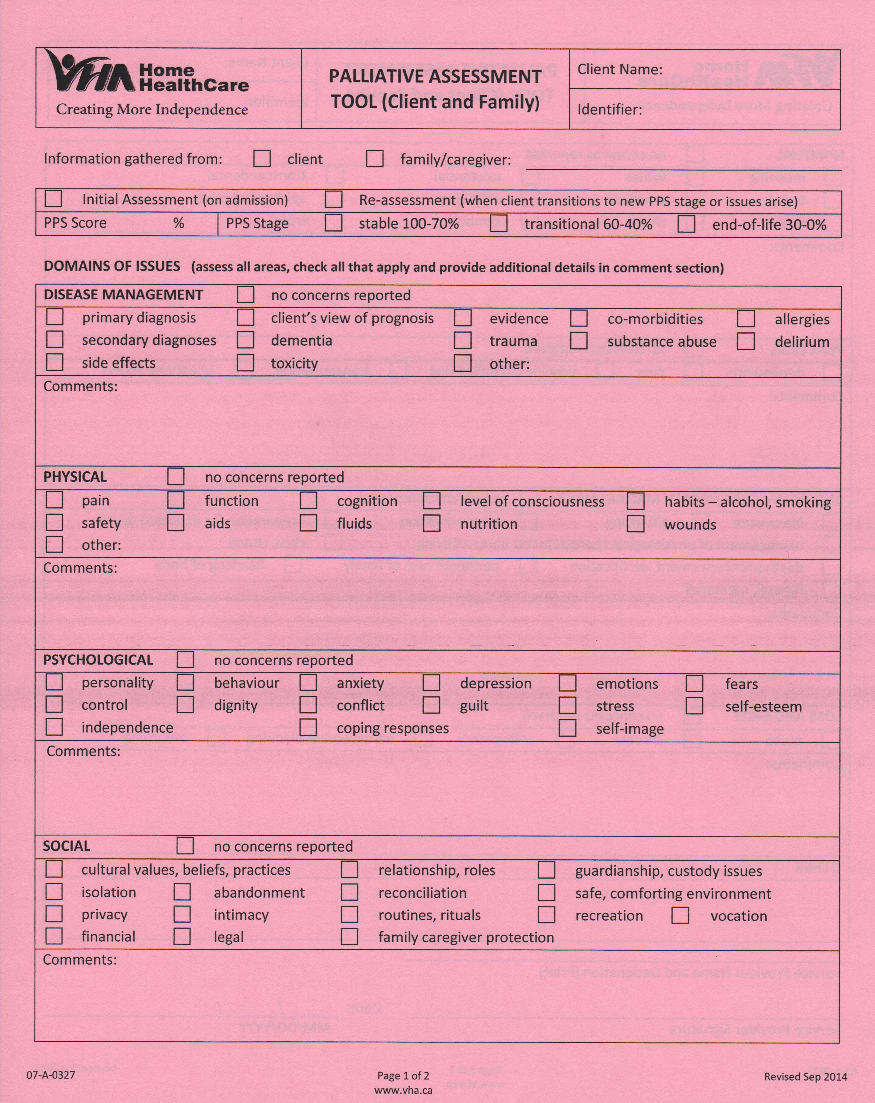
Method #2
Colored Forms
Implemented January 15th 2018
Increase visibility of the pain tools
Notes:
The colored forms were implemented on January 15th 2018, to increase the visibility of the pain tools within the chart.

Slide 13
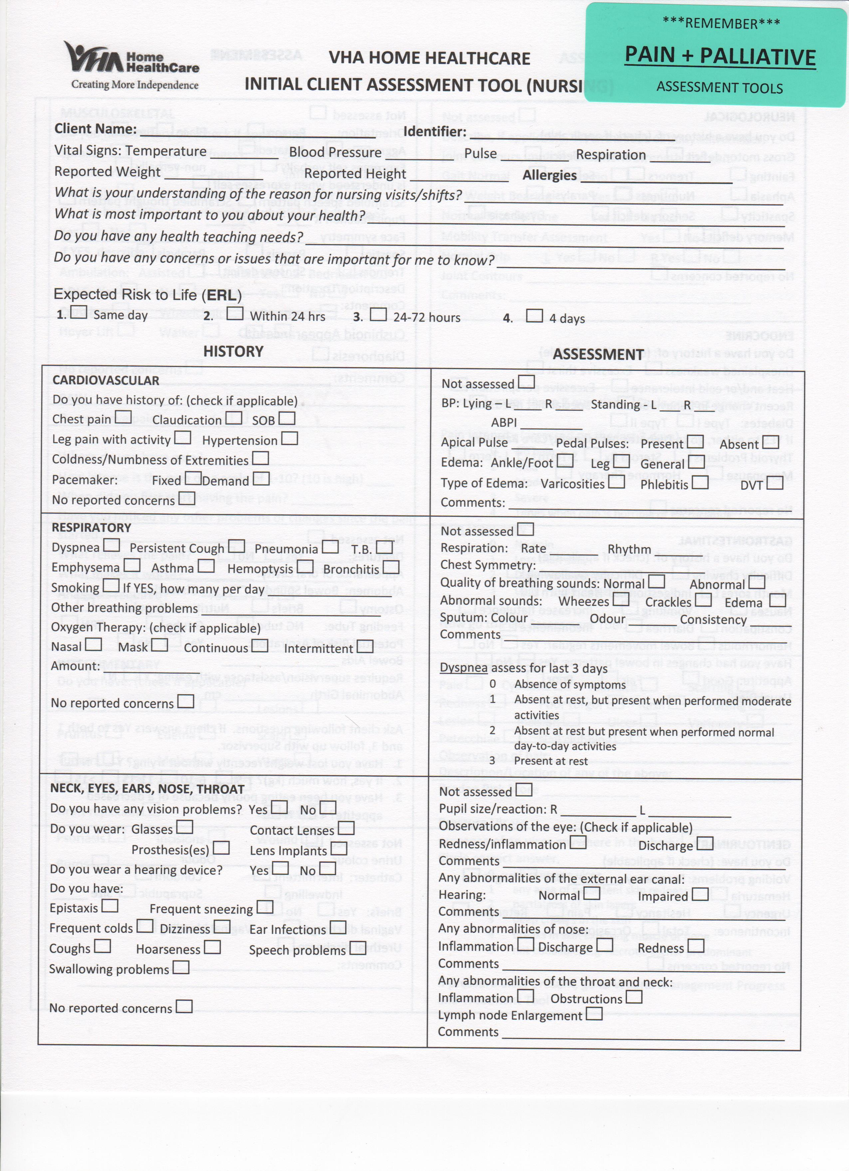
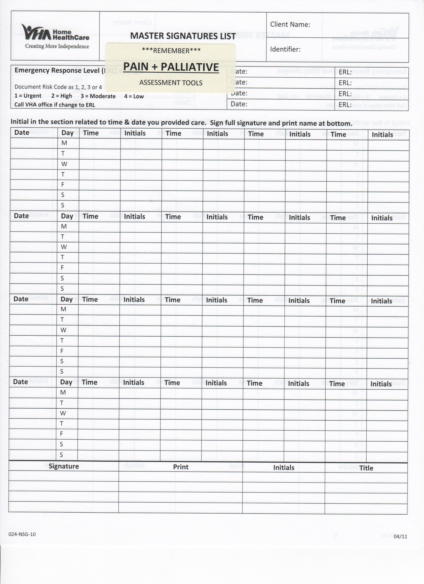
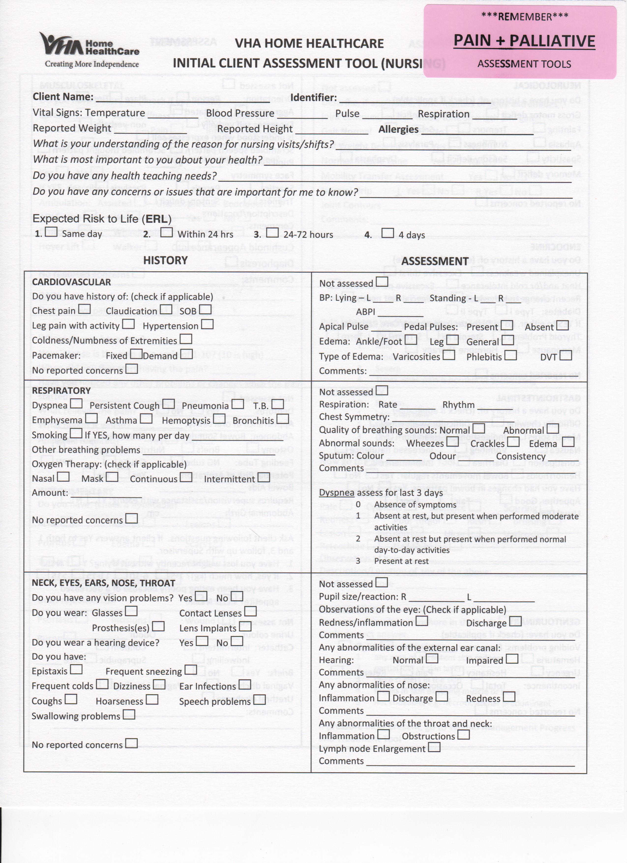
Method #3
Reminder Stickers
February 2 – 23 2018
January 15 – 31 2018
Notes:
The third method used was to gently remind the nurses to review the pain and palliative assessment tools prior to the end of their nursing visit. This was done by placing bright neon colored stickers on frequently used forms in the nursing chart.

Slide 14
Method #4
Communication Strategy
January 15 – 31 2018
12 phone call interviews among 8 nursing staff in a 2 week period
Feb 1 – 14 2018
4 emails to nursing team inbox of 12 staff in a 2 week period
Feb 15 – Feb 23 2018
2 text messages, plus 2 emails sent to nursing team inbox of 12 staff in a 1 week period
Notes:
The 4th method used was to create a communication strategy that encouraged maximum feedback from the nurses at the point of care. I had monitored the use of the forms as well as the comfort to use them through follow-up phone calls done on average once a day for 2 weeks between 8 nurses, 4 emails sent to the nursing team inbox for a total of 12 nurses in a 2 week period, and 2 text messages plus 2 emails sent to nursing team inbox of 12 staff in a 1 week period.
Weekly phone calls to nurses from Jan 15 – Jan 31 2018 (12 days of phone calls between 8 nurses)
Weekly emails to nursing team from Feb 1 – Feb 14 2018 (2 emails/week to all 12 nurses on the team)
Text messages twice a week to nursing team from Feb 15 – Feb 23 2018, along with 2 emails with deadline reminders (2 texts, 1 response. 2 emails with supervisor encouragement, due date written in red)

Slide 15
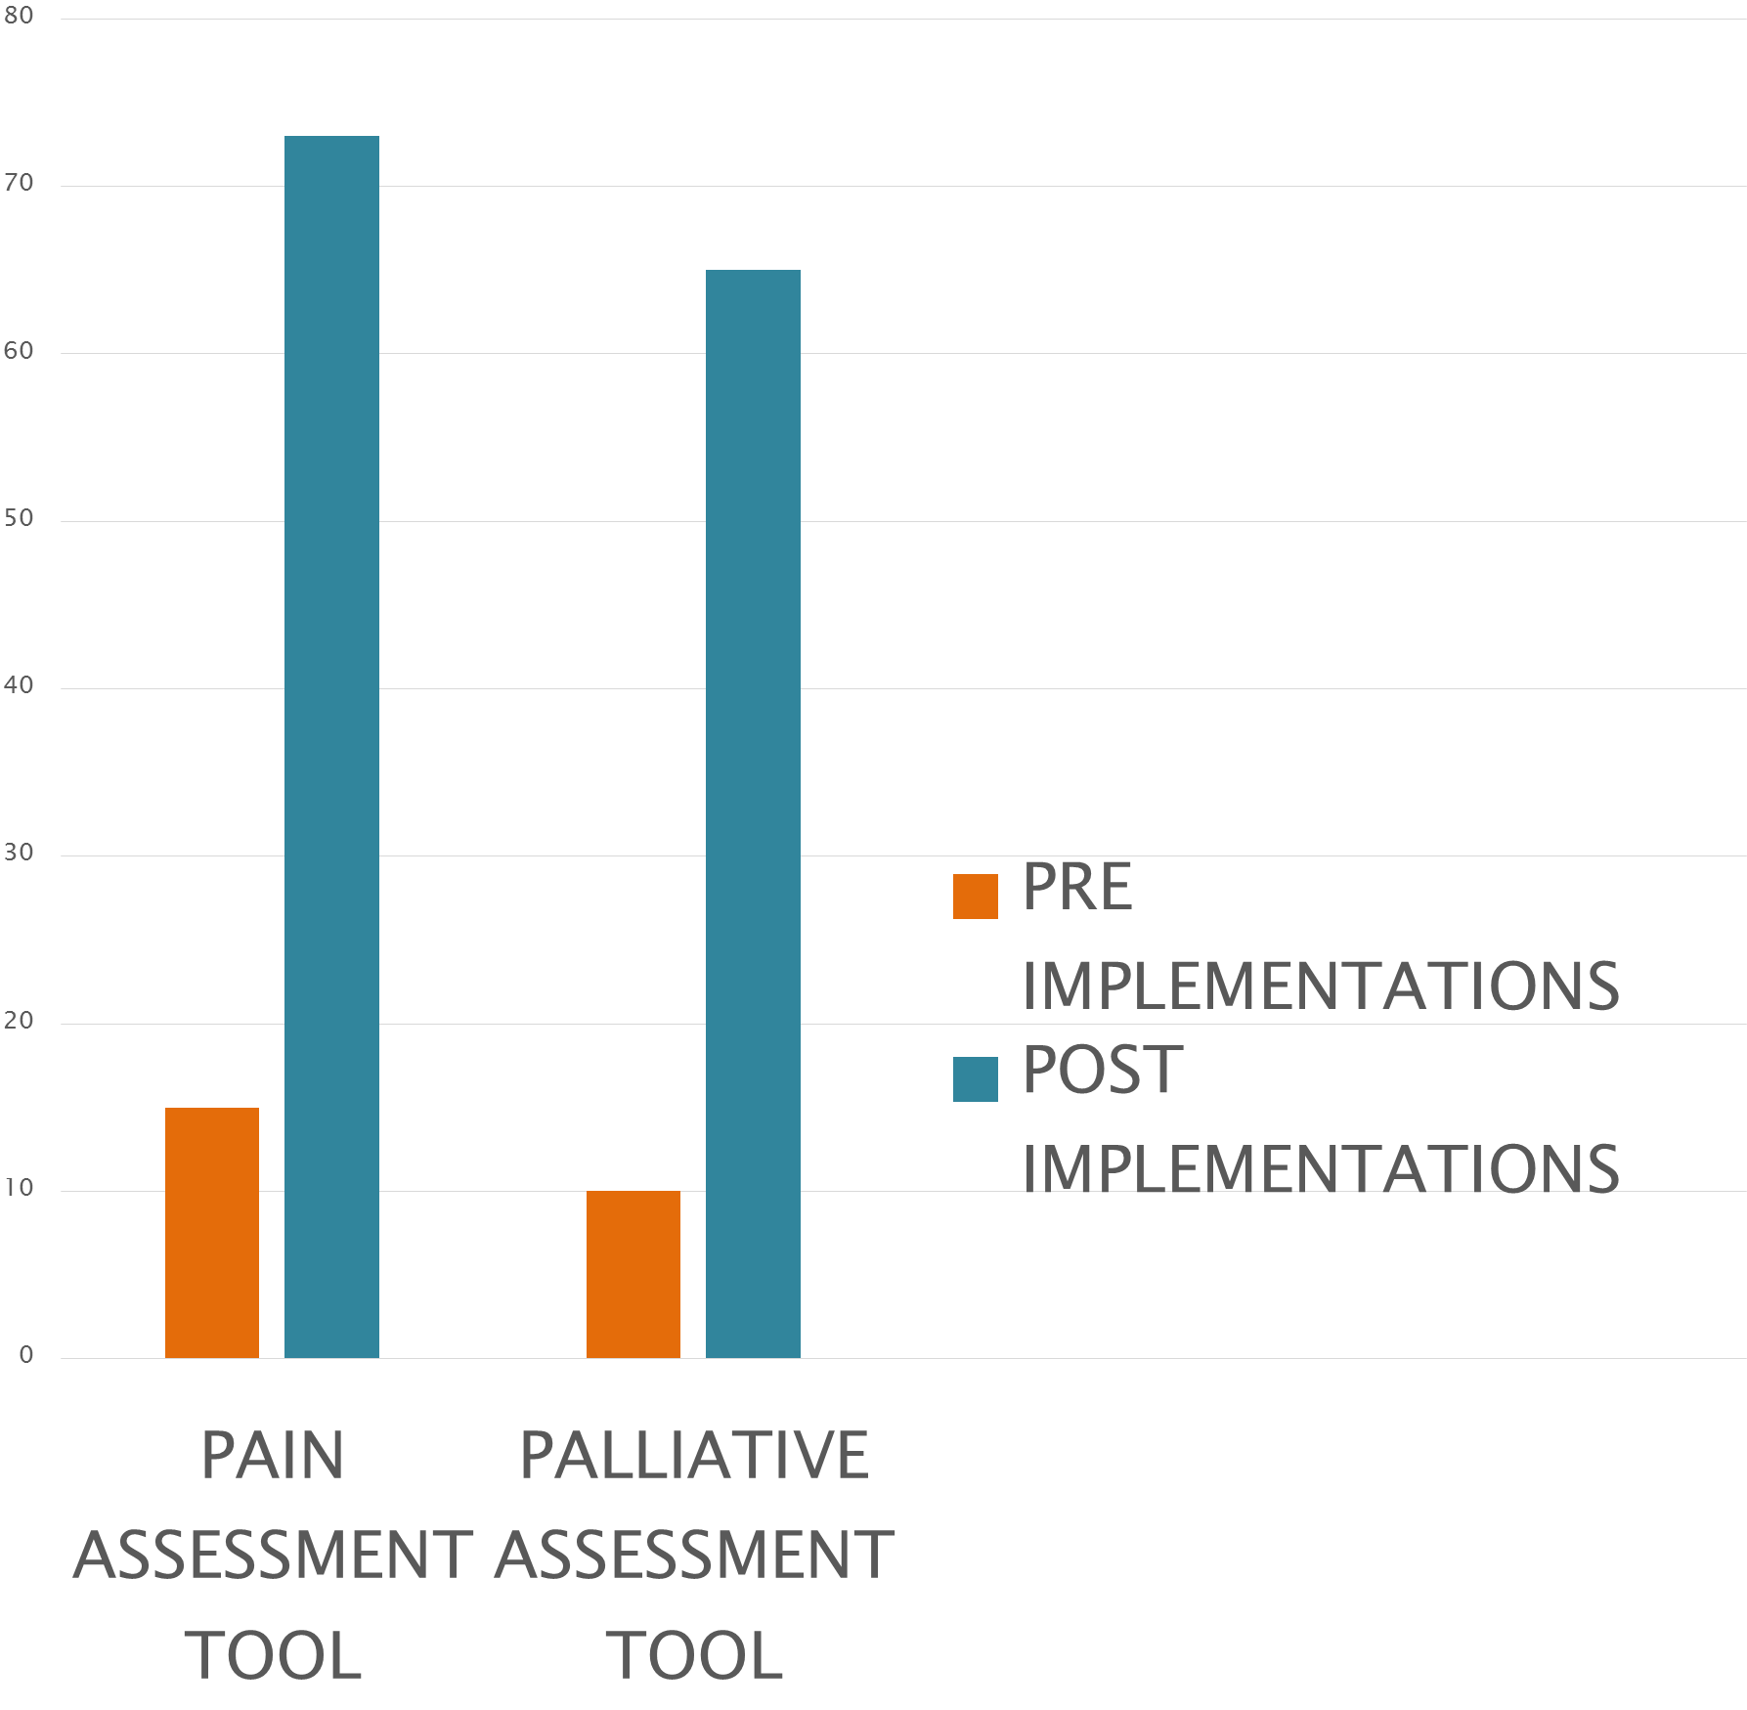
Results of Assessment Tool Completion
Percentage of 26 Discharged Palliative Care Nursing Charts from the Scarborough Region using the Pain and Palliative Assessment Tools
Percentage of charts using pain and palliative assessment tools
Notes:
Near the end of February 2018, I was able to gather the results of the use of both pain tools. The pain assessment tool was increased from 15% usage, to 73% usage, and the palliative assessment tool was increased from 10% usage, to 65% usage. This is a direct reflection of the impact the combination of the educational video, reminder strategies, and communication strategies all had towards improving the quality of total pain documentation.

Slide 16
Facilitators Barriers
Pink forms easy to locate and stands out
Able to retrieve specific details in a structured format
Educational video is remotely accessible
Time restriction to complete both forms upon first nursing admission assessment
Confusion where to locate educational video
Difficulty accessing forgotten username and password to enter iLearn
Notes:
The feedback received from the visiting nursing staff provided some great insight on their thoughts of these tools. These are some examples of the feedback received during the follow up phone calls:
The facilitators:
Pink forms easy to locate and stands out
Able to retrieve specific details in a structured format
Educational video is remotely accessible
The barriers:
Time restriction to complete both forms upon first nursing admission assessment
Confusion where to locate educational video
Difficulty accessing forgotten username and password to enter iLearn

Slide 17
Conclusion
Next Steps
Recommendations
Sustainability Plan
Continue using pink paper for pain tools
Continue developing newly organized palliative chart structure
New hires gain exposure to pink forms during training by Clinical Lead
Create a “Part 2” case scenario video, as requested by nursing staff
Pink forms financially feasible (3$/1000 pages)
Educational video now mandatory for all new palliative team hires and automated emails sent for annual review
Notes:
Next Steps
Organize with external printing source to continue using pink paper for printing the Pain and Palliative Assessment Tools
Continue collaborating with the Clinical Lead and Supervisor in rolling out the newly organized palliative chart structure
Further Recommendations
Clinical Lead is to expose new hires to use these forms while training, and continue to encourage the ongoing use of the forms throughout practice.
Create a “part 2” case scenario video, as there was a high interest of this section displayed amongst nurses, and revealed a positive learning experience was expressed.
Sustainability Plan
Pink forms to remain as they are financially feasible
Educational video now mandatory for all new palliative care team members, and annual review also set to be automated.

Slide 18

Notes:
By incorporating these practice changes, VHA can ensure a best-practice assessment strategy to conducting a total pain assessment with the palliative population. By using the pain and palliative assessment tools, the nurses will be able to sustain concise and consistent flow of information and communication throughout the clients services, and ultimately, improve client-centered care.

Slide 19
Acknowledgements
Kathryn Nichol, RN PhD, VP BPRE & CEO
Sandra McKay, Manager, Research
Arlinda Ruco, Mentor and Research Associate
CAP/TAHSNp Fellowship Program Facilitators
Enrique Saenz, Client Service Manager, Central East Region
Akil Ade, Supervisor Scarborough Palliative Region
Records Management Team
Visiting Palliative Nurses Scarborough Team
Client Service Coordinator Palliative Team

Slide 20
Questions?

Slide 21
References
pain. (n.d.). Collins English Dictionary - Complete & Unabridged 10th Edition. Retrieved November 21, 2017 from Dictionary.com website http://www.dictionary.com/browse/pain
Canadian Hospice Palliative Care Association. The Pan-Canadian Gold Standard for Palliative Home Care: Towards Equitable Access to High Quality Hospice Palliative and End-of-Life Care at Home, p. 4 citation, Ottawa, ON: Canadian Hospice Palliative Care Association, 2006
Southwestern Ontario Hospice Palliative Care Education Program. The Fundamentals of Hospice Palliative Care. London: Southwestern Ontario Hospice Palliative Care Education Program, St. Joseph’s Healthcare London;2013.
Dubey V, Mathew R, Iglar K, Duerksen A (2015), Preventative Care Checklist Forms from http://www.cfpc.ca/projectassets/templates/resource.aspx?id=1184&langType=4105
McCarter K, Britton B, Baker A, et al Interventions to improve screening and appropriate referral of patients with cancer for distress: systematic review protocol BMJ Open 2015;5:e008277. doi: 10.1136/bmjopen-2015-008277
John Wiley & Sons, Ltd, 2009, Cochrane Database of Systematic Reviews, Continuing education meetings and workshops: effects on professional practice and health care outcomes, p. 1,2,5, 10.1002/14651858.CD003030.pub2 from http://dx.doi.org/10.1002/14651858.CD003030.pub2
Karena M Conroy, Doug Elliott, Anthony R Burrell, 2013 Oct 3, Developing content for a process-of-care checklist for use in intensive care units: a dual-method approach to establishing construct validity, BMC Health Services Research, doi: 10.1186/1472-6963-13-380 from https://www.ncbi.nlm.nih.gov/pmc/articles/PMC3852734/

