Slide 1
Assessment, Readiness & Clutter Support
Alda Melo, MSc OT Reg Ont
Catherine Chater Msc. Ot Reg ONT
www.vha.ca

Slide 2
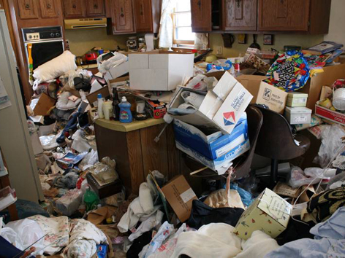
Notes:
2

Slide 3
When I see this….
How do I feel? What am I thinking?
“Hoarders are gross!!”
“Every time I watch this show I clean my entire room.”
“Poor thing she needs help ”
“OMG! this is disgusting!”
“This woman is simply ... lazy”
“Easy. Hire a dump truck and haul it all to the dump.”
Notes:
3
Disgust
Sympathy
Fix it!
Blame, Judgement is protective defense
Clear Out
Others more interested in change than person with disorder:Anecdotally, the present authors
receive inquiries from frustrated family members approximately twice as often as they do from individuals
with compulsive hoarding problems. [Tolin family burden 2008]. Low insight
Low treatment response
Risks of clutter

Slide 4

When I see this….
How do I feel? What am I thinking?
Health workers report:
frustration, irritation,
hopelessness, helplessness
debating/arguing with client
relief when client is no-show or
a desire to transfer.
PRS correlates with working alliance
(but not hoarding symptom severity)
Recognize Hoarding Disorder =
Chronic, complex, diminished
insight, limited Tx adherence
… how to develop good plan to help
Patient Rejection Scale (PRS)
To what extent did your client:
show insight into the nature of her/his problems with hoarding?”
display poor problem-solving skills?
have difficulty answering questions about hoarding or other problems appropriately?” (providing too much info, irrelevant info, etc.)
[Tolin, Frost, Steketee, 2012; Working with hoarding vs. non-hoarding clients: A survey of professional’s attitudes and experiences. JOCD; 1: 48-53]
Notes:
4
Disgust
Sympathy
Fix it!
Blame, Judgement is protective defense
Clear Out
Others more interested in change than person with disorder:Anecdotally, the present authors
receive inquiries from frustrated family members approximately twice as often as they do from individuals
with compulsive hoarding problems. [Tolin family burden 2008]. Low insight
Low treatment response
Risks of clutter

Slide 5

Today’s Objectives
Here’s where we are going
By the end of this session:
Name two main types of approach to treating Hoarding Disorder (HD)
(What can be done to help)
List an assessment tool to identify key safety/eviction risks and preferred Tx approach
(What to assess for so as to know how to best help)
Identify one strategy (or more!) to set up and address your plan of service.
(How you can develop a plan to help based on your assessment)

Slide 6
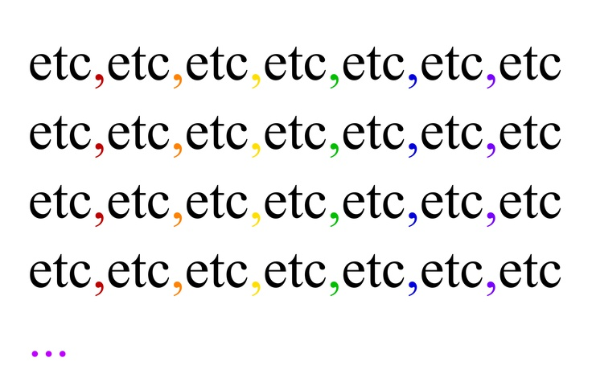
Hoarding Assessment
What to assess & document
Client Demographics:
Age, gender, marital status, address, number of occupants in the home …
Medical Status:
Diagnosis, comorbidities, past medical history, surgeries, medications …
Goals of Client:
Motivation to change, reasons for addressing hoarding, desired outcomes (client, referral source, others) …
Support Network:
Family relationships, health professionals medical care..
Status of the Home:
Volume of clutter, usability of rooms, content of clutter, structural issues,…
Hoarding History:
Time of onset, circumstances of onset, family history, client’s perspective of etiology …
Acquisition Habits:
Volume/frequency of acquisition, types of objects, financial circumstances, locations of acquisition …
Treatment History:
Type(s) of treatment modalities, success,
nature of therapeutic alliance …

Slide 7
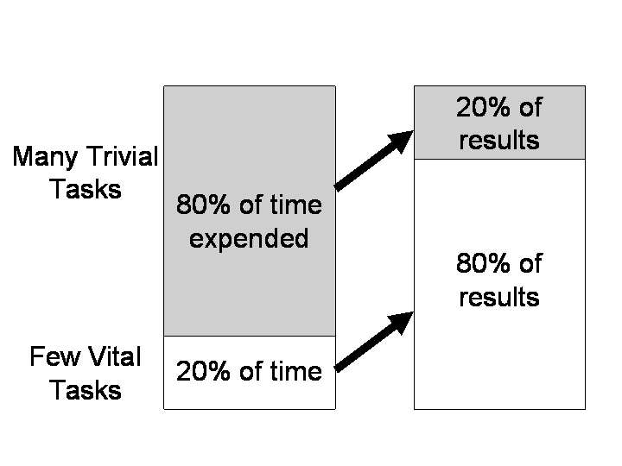


Assessment = What do I need to know to best help?
Pareto Principle …. For Hoarding
Look for indicators in the person and their environment that are most likely to be changeable and positively impact the situation.
The 80:20 Rule

Slide 8
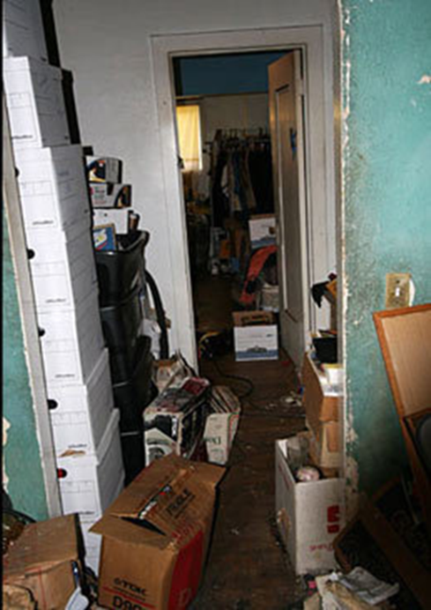

What does help?
Two types of services
Cognitive Behavioural Therapy Harm Reduction
Which service will remove the clutter & prevent it from returning?

Slide 9
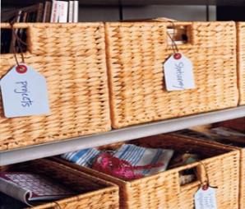




Cognitive Behavioural Therapy for HD
Teaching skills, emotional regulation
1. Adjust
thinking
patterns
Organization Skills
+
3. Sorting/
discard
training
+
4. Exposure to
non-acquiring
+
Motivation
Strategies
Notes:
Treatment for Compulsive Hoarding
Preliminary research has suggested that traditional cognitive behavior therapy (CBT) and exposure and response prevention (ERP), which are effective for treating other types of OCD, may not be as helpful in treating individuals suffering from compulsive hoarding
(Abramowitz, Franklin, Schwartz, & Furr, 2003; Frost & Hartl, 1996; Frost & Steketee, 1998; Steketee & Frost, 2003). This has led to efforts to develop a specialized form of CBT specifically designed for treating compulsive hoarding (Steketee & Frost, 2007). Preliminary investigation of this treatment suggests that it is effective (Tolin, Frost, & Steketee, 2007). In this treatment protocol, patients receive 26 weekly sessions of individual CBT in addition to monthly home visits over a 9- to 12-month time period.
[Ethical Considerations in the Treatment of Compulsive Hoarding. Gibson et al 2010]
[An open trial of cognitive-behavioral therapy for compulsive hoarding, Tolin, Frost, Steketee 2001]
The aim of the present study was to provide preliminary data on the efficacy of a new cognitive-behavioral treatment
(CBT) for compulsive hoarding. Fourteen adults with compulsive hoarding (10 treatment completers) were seen in two
specialty CBT clinics. Participants were included if they met research criteria for compulsive hoarding according to a
semistructured interview, were age 18 or above, considered hoarding their main psychiatric problem, and were not
receiving mental health treatment. Patients received 26 individual sessions of CBT, including frequent home visits, over a
7–12 month period between December 2003–February 2005. Primary outcome measures were the Saving Inventory-
Revised (SI-R), Clutter Image Rating (CIR), and Clinician’s Global Impression (CGI). Significant decreases from pre- to
post-treatment were noted on the SI-R and CIR, but not the CGI-severity rating. CGI-Improvement ratings indicated that
at mid-treatment, 40% (n ¼ 4) of treatment completers were rated ‘‘much improved’’ or ‘‘very much improved;’’ at posttreatment,
50% (n ¼ 5) received this rating. Adherence to homework assignments was strongly related to symptom
improvement. CBT with specialized components to address problems with motivation, organizing, acquiring and removing
clutter appears to be a promising intervention for compulsive hoarding, a condition traditionally thought to be resistant to
treatment.
Treatment:
26 session, 7-12 months, x1/week with flexibility for motivation and scheduling, 1-1.5 hr in office & 2 hour home visits, visits 1-3/5: assessment, MI, home assessment; intervention targeted disorganization, compulsive acquisition, difficulty discarding by 1) skills training organization, problem solving, decision-making 2) imaginal/direct exposure 3) cognitive restructuring of hoarding beliefs

Slide 10




Cognitive Behavioural Therapy for HD
Teaching skills, emotional regulation
Goals of CBT:
Reduce frequency of hoarding behaviours
Teach skills to re-appraise need to hold onto
or acquire belongings
Improve ability to regulate emotions
Treat symptoms to reduce impairment
Notes:
Treatment for Compulsive Hoarding
Preliminary research has suggested that traditional cognitive behavior therapy (CBT) and exposure and response prevention (ERP), which are effective for treating other types of OCD, may not be as helpful in treating individuals suffering from compulsive hoarding
(Abramowitz, Franklin, Schwartz, & Furr, 2003; Frost & Hartl, 1996; Frost & Steketee, 1998; Steketee & Frost, 2003). This has led to efforts to develop a specialized form of CBT specifically designed for treating compulsive hoarding (Steketee & Frost, 2007). Preliminary investigation of this treatment suggests that it is effective (Tolin, Frost, & Steketee, 2007). In this treatment protocol, patients receive 26 weekly sessions of individual CBT in addition to monthly home visits over a 9- to 12-month time period.
[Ethical Considerations in the Treatment of Compulsive Hoarding. Gibson et al 2010]
[An open trial of cognitive-behavioral therapy for compulsive hoarding, Tolin, Frost, Steketee 2001]
The aim of the present study was to provide preliminary data on the efficacy of a new cognitive-behavioral treatment
(CBT) for compulsive hoarding. Fourteen adults with compulsive hoarding (10 treatment completers) were seen in two
specialty CBT clinics. Participants were included if they met research criteria for compulsive hoarding according to a
semistructured interview, were age 18 or above, considered hoarding their main psychiatric problem, and were not
receiving mental health treatment. Patients received 26 individual sessions of CBT, including frequent home visits, over a
7–12 month period between December 2003–February 2005. Primary outcome measures were the Saving Inventory-
Revised (SI-R), Clutter Image Rating (CIR), and Clinician’s Global Impression (CGI). Significant decreases from pre- to
post-treatment were noted on the SI-R and CIR, but not the CGI-severity rating. CGI-Improvement ratings indicated that
at mid-treatment, 40% (n ¼ 4) of treatment completers were rated ‘‘much improved’’ or ‘‘very much improved;’’ at posttreatment,
50% (n ¼ 5) received this rating. Adherence to homework assignments was strongly related to symptom
improvement. CBT with specialized components to address problems with motivation, organizing, acquiring and removing
clutter appears to be a promising intervention for compulsive hoarding, a condition traditionally thought to be resistant to
treatment.
Treatment:
26 session, 7-12 months, x1/week with flexibility for motivation and scheduling, 1-1.5 hr in office & 2 hour home visits, visits 1-3/5: assessment, MI, home assessment; intervention targeted disorganization, compulsive acquisition, difficulty discarding by 1) skills training organization, problem solving, decision-making 2) imaginal/direct exposure 3) cognitive restructuring of hoarding beliefs

Slide 11
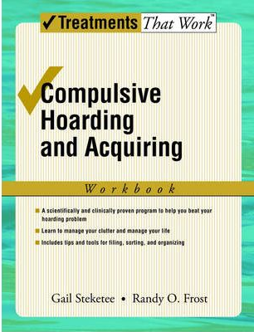
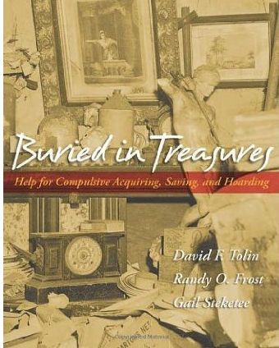
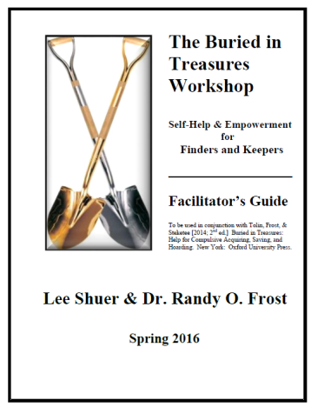

CBT Treatment for Hoarding Disorder
Linking your clients to service
CBT-trained therapists
Outpatient mental health clinics
Sunnybrook: Dx & group CBT
        416-480-6100
Guided bibliotherapy
Delivery by non-clinicians
Outcomes comparable
Web Search: Facilitator’s Guide
C.A.Mathews, et al., Psychiatry Res. 237 (2016) 331–338 | R.O. Frost, D. Ruby, L. Shuer, Behav. Res. Ther. 50 (2012) 661–667 | Uhm, SY et al., Contemporary Clinical Trials 50(2016): 98-105.]

Slide 12

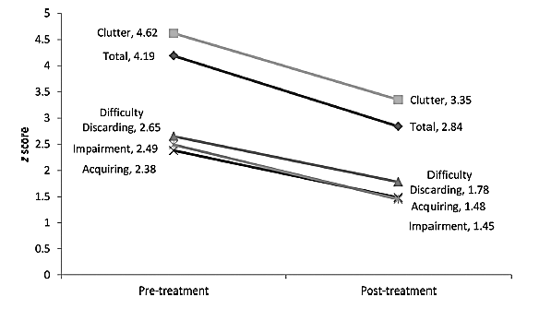
CBT Effectiveness
Room for Improvement
  Costly
  Can take ~1 year to complete
  Few clinicians are trained
Treatment results
Moderate Treatment Effects
Treatment completers:
Most change with
Difficulty Discarding
Better outcomes with Women, Younger age, Greater number of CBT sessions
Clutter
Total (SIR)
Discarding
Acquiring,
Impairment
Tolin, Frost, Steketee, Muroff. CBT for Hoarding Disorder: a Meta-Analysis Depression & Anxiety 32: 158-166
Notes:
Treatment for Compulsive Hoarding
Preliminary research has suggested that traditional cognitive behavior therapy (CBT) and exposure and response prevention (ERP), which are effective for treating other types of OCD, may not be as helpful in treating individuals suffering from compulsive hoarding
(Abramowitz, Franklin, Schwartz, & Furr, 2003; Frost & Hartl, 1996; Frost & Steketee, 1998; Steketee & Frost, 2003). This has led to efforts to develop a specialized form of CBT specifically designed for treating compulsive hoarding (Steketee & Frost, 2007). Preliminary investigation of this treatment suggests that it is effective (Tolin, Frost, & Steketee, 2007). In this treatment protocol, patients receive 26 weekly sessions of individual CBT in addition to monthly home visits over a 9- to 12-month time period.
[Ethical Considerations in the Treatment of Compulsive Hoarding. Gibson et al 2010]
[An open trial of cognitive-behavioral therapy for compulsive hoarding, Tolin, Frost, Steketee 2001]
The aim of the present study was to provide preliminary data on the efficacy of a new cognitive-behavioral treatment
(CBT) for compulsive hoarding. Fourteen adults with compulsive hoarding (10 treatment completers) were seen in two
specialty CBT clinics. Participants were included if they met research criteria for compulsive hoarding according to a
semistructured interview, were age 18 or above, considered hoarding their main psychiatric problem, and were not
receiving mental health treatment. Patients received 26 individual sessions of CBT, including frequent home visits, over a
7–12 month period between December 2003–February 2005. Primary outcome measures were the Saving Inventory-
Revised (SI-R), Clutter Image Rating (CIR), and Clinician’s Global Impression (CGI). Significant decreases from pre- to
post-treatment were noted on the SI-R and CIR, but not the CGI-severity rating. CGI-Improvement ratings indicated that
at mid-treatment, 40% (n ¼ 4) of treatment completers were rated ‘‘much improved’’ or ‘‘very much improved;’’ at posttreatment,
50% (n ¼ 5) received this rating. Adherence to homework assignments was strongly related to symptom
improvement. CBT with specialized components to address problems with motivation, organizing, acquiring and removing
clutter appears to be a promising intervention for compulsive hoarding, a condition traditionally thought to be resistant to
treatment.
Treatment:
26 session, 7-12 months, x1/week with flexibility for motivation and scheduling, 1-1.5 hr in office & 2 hour home visits, visits 1-3/5: assessment, MI, home assessment; intervention targeted disorganization, compulsive acquisition, difficulty discarding by 1) skills training organization, problem solving, decision-making 2) imaginal/direct exposure 3) cognitive restructuring of hoarding beliefs

Slide 13

CBT Effectiveness – Clinical Significance
Clinically significant change Less Robust
With 13-35 CBT sessions by trained facilitator; in home & clinic:
Tolin, Frost, Steketee, Muroff. CBT for Hoarding Disorder: a Meta-Analysis Depression & Anxiety 32: 158-166
Effect Size: Clinically Significant Change
Difficulty Discarding .89 34%
Acquisition: 0.72 40% lower pre-Tx severity
Clutter 0.70 25% Highest pre-Tx severity, correlates with # of sessions (clinic & in home) – suggests decluttering is a time consuming and laborious process & f/up data suggests does not continue to decrease post intervention (? May find so with external supports).
Impairment 0.52 43% Lower pre-Tx severity
Successful decluttering for may require more time and intervention beyond that represented in most CBT trials. Additional research is needed to determine whether longer-term practical supports such as help with cleaning (sorting, organizing) would improve the efficacy of Tx of reduced clutter in patients who have received CBT.
Younger, female
dd
Notes:
Meta-analysis N=232, 12 studies, group & individual CBT # sessions = 13-35, in-home ranged from 0-33

Slide 14
CBT Effectiveness – DIFFICULTY DISCARDING
Clinically significant change Less Robust
# post treatment scores fit with general population, not hoarding population:
Symptomatic
Tolin, Frost, Steketee, Muroff. CBT for Hoarding Disorder: a Meta-Analysis Depression & Anxiety 32: 158-166
Effect Size: Clinically Significant Change
Difficulty Discarding .89 34%
Acquisition: 0.72 40% lower pre-Tx severity
Clutter 0.70 25% Highest pre-Tx severity, correlates with # of sessions (clinic & in home) – suggests decluttering is a time consuming and laborious process & f/up data suggests does not continue to decrease post intervention (? May find so with external supports).
Impairment 0.52 43% Lower pre-Tx severity
Successful decluttering for may require more time and intervention beyond that represented in most CBT trials. Additional research is needed to determine whether longer-term practical supports such as help with cleaning (sorting, organizing) would improve the efficacy of Tx of reduced clutter in patients who have received CBT.
Younger, female
dd
Notes:
Meta-analysis N=232, 12 studies, group & individual CBT # sessions = 13-35, in-home ranged from 0-33

Slide 15
CBT Effectiveness - CLUTTER
Clinically significant change Less Robust
# post treatment scores fit with general population, not hoarding population:
!
In-home sessions improve clutter, discarding, impairment outcomes
To be effective, more time and intervention may be required than is typically provided with CBT.
Tolin, Frost, Steketee, Muroff. CBT for Hoarding Disorder: a Meta-Analysis Depression & Anxiety 32: 158-166
Effect Size: Clinically Significant Change
Difficulty Discarding .89 34%
Acquisition: 0.72 40% lower pre-Tx severity
Clutter 0.70 25% Highest pre-Tx severity, correlates with # of sessions (clinic & in home) – suggests decluttering is a time consuming and laborious process & f/up data suggests does not continue to decrease post intervention (? May find so with external supports).
Impairment 0.52 43% Lower pre-Tx severity
Successful decluttering for may require more time and intervention beyond that represented in most CBT trials. Additional research is needed to determine whether longer-term practical supports such as help with cleaning (sorting, organizing) would improve the efficacy of Tx of reduced clutter in patients who have received CBT.
Younger, female
dd
Notes:
Meta-analysis N=232, 12 studies, group & individual CBT # sessions = 13-35, in-home ranged from 0-33

Slide 16

Addressing the Clutter
the person is the key
“I want to know how to help my client with their
hoarding problem”
=
“Tell me how to get them to clear out the clutter!”
100……. 75……... 50…….. 25…...0
%True?

Slide 17
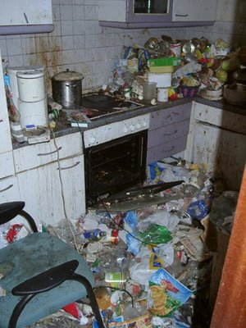

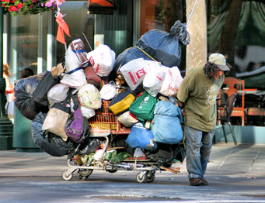
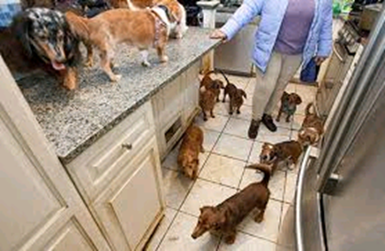
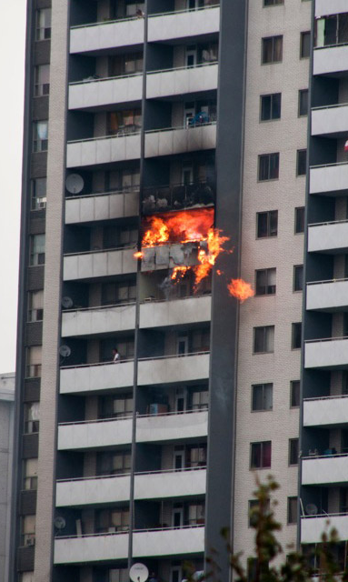

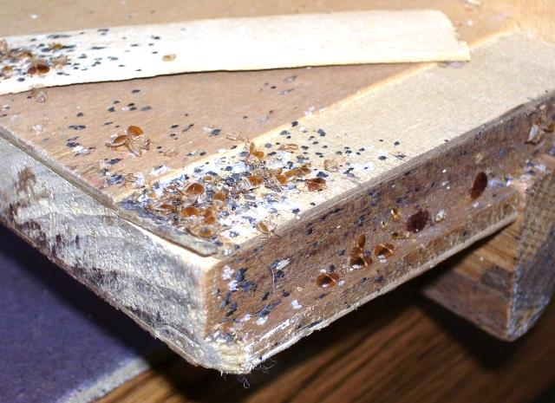


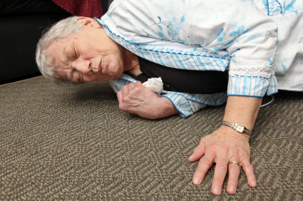
Harm Reduction – Reduce Safety Risks
Fire … Eviction ...Infestations …. unsanitary conditions …
Notes:
17
Situations of extreme clutter expose individuals, families, and communities to serious health and safety risks including homelessness, fire and infestation [Steketee, G., Frost, R.O., Kim, H.J., 2001. Hoarding by elderly people. Health and Social Work 26, 176–184]
Excess clutter is a substantial contributor to bedbug and other infestations, and can render pest control treatment ineffective [McDonald, L. & R. Zavys, 2009. Bed Bugs are Back. Woodgreen Community Services, Toronto.]
Extreme clutter can expose clients to falls, fires, floods, infestations, respiratory problems, and difficulty accessing emergency services.
Eviction and other court proceedings may result in homelessness, hospitalization or even an unwanted move into a long-term care facility [Damecour & Charron, 1998, Frost Steketee & Williams, 2000; Steketee & Frost, 2003; Thomas, 1997
Often people who hoard cannot heat or cool their homes because clutter blocks the heating or cooling vents. Their homes are often in disrepair because they will not let someone into their home to repair the roof, sink, or toilet because they are ashamed or because they fear discovery. About half of those who suffer from compulsive hoarding are unable to use their stovetops, refrigerators, tubs or sinks, and 1 in 10 is unable to use the toilet (Frost et al., 2000). They are at risk of slipping and falling in the clutter, which is particularly dangerous for frail, older adults. [Working With Families of People Who Hoard: A Harm Reduction Approach; Michael A. Tompkins, 2011].

Slide 18
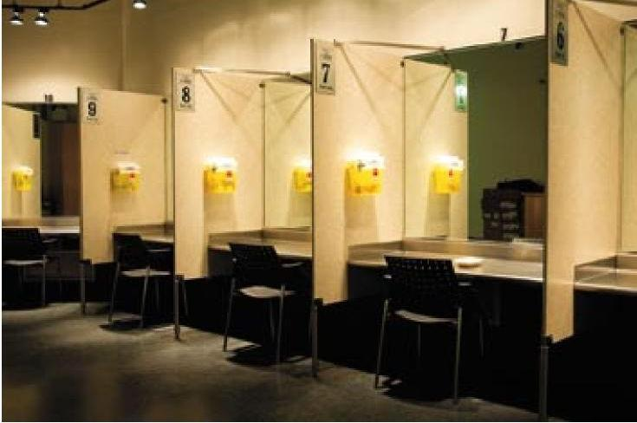
Harm Reduction for Hoarding Disorder
Decrease consequences of high risk behaviors
Does not require the individual stops hoarding.
Harm Reduction focuses on organizing & discarding only that which is necessary to maintain the person in their home with improved safety & comfort.
Manage symptoms to reduce risk
(Tompkins & Hartl, 2009; Working with Families of People who Hoard:
A Harm Reduction Approach, Tompkins et al 2011).
Notes:
[Working With Families of People Who Hoard: A Harm Reduction Approach, Michael A. Tompkins, 2011]
HR makes sense for compulsive hoarding are a follows: (a) many people who hoard refuse help, (b) an over-emphasis on
discarding may make things worse, and (c) in most cases, compulsive hoarding is too big a problem for any one person to manage.
Family-Based HR for Hoarding Behavior
Our HR model for compulsive hoarding (Tompkins & Hartl, manuscript) involves five steps:
1. Engage the person who hoards in the HR approach.
2. Build the HR team.
3. Assess harm potential.
4. Create the HR plan.
5. Implement the HR plan.
Description
HR engages the person who hoards and his or her family with motivational interviewing
Clinician works to build the HR team. The team includes the clinician and the person who hoards and also family members, friends, and other stakeholders, such as Adult Protective Service workers, housing code enforcement officers, property managers, or visiting nurses.
Clinician arranges a series of home visits to assess the harm potential of the hoarding situation. The clinician focuses the assessment on three factors— environmental, person, and support—that influence the degree of risk persons who hoard experience living in their homes. Environmental factors focus on features of the living situation itself, such as whether clutter covers the heating and cooling vents, stairs, and stovetops, or whether the person who hoards can easily exit in case of a fire. Person factors focus on features of persons who hoard themselves, such as their motivation to reduce the danger of their hoarding behavior, whether they have medical problems, use walkers or canes, and have additional psychiatric conditions. Support factors focus on features of the support system of hoarders, such as whether they have family members who live with them or nearby, are receiving social support services, are spending time with others (friends, family, and caregivers) outside their homes.
With the person who hoards engaged, the team assembled, and the harm assessment completed, the clinician then works with the team members to develop the HR plan and formalizes it with a contract. The HR plan specifies the targets, the frequency of home visits and team meetings, and the role of each team member. HR targets include not only areas to clear and keep clear but also the ways people acquire possessions or the ways possessions enter their homes that the team strives to stop or limit.

Slide 19
Harm Reduction for Hoarding Disorder
Decrease consequences of high risk behaviors
Does not require the individual stops hoarding.
Goals of Harm Reduction:
Improve safety of client
Move possessions to reduce hazards
Support to organize
Decluttering/cleaning of high risk spaces
No End Date!
(Tompkins & Hartl, 2009; Working with Families of People who Hoard:
A Harm Reduction Approach, Tompkins et al 2011).
Notes:
[Working With Families of People Who Hoard: A Harm Reduction Approach, Michael A. Tompkins, 2011]
HR makes sense for compulsive hoarding are a follows: (a) many people who hoard refuse help, (b) an over-emphasis on
discarding may make things worse, and (c) in most cases, compulsive hoarding is too big a problem for any one person to manage.
Family-Based HR for Hoarding Behavior
Our HR model for compulsive hoarding (Tompkins & Hartl, manuscript) involves five steps:
1. Engage the person who hoards in the HR approach.
2. Build the HR team.
3. Assess harm potential.
4. Create the HR plan.
5. Implement the HR plan.
Description
HR engages the person who hoards and his or her family with motivational interviewing
Clinician works to build the HR team. The team includes the clinician and the person who hoards and also family members, friends, and other stakeholders, such as Adult Protective Service workers, housing code enforcement officers, property managers, or visiting nurses.
Clinician arranges a series of home visits to assess the harm potential of the hoarding situation. The clinician focuses the assessment on three factors— environmental, person, and support—that influence the degree of risk persons who hoard experience living in their homes. Environmental factors focus on features of the living situation itself, such as whether clutter covers the heating and cooling vents, stairs, and stovetops, or whether the person who hoards can easily exit in case of a fire. Person factors focus on features of persons who hoard themselves, such as their motivation to reduce the danger of their hoarding behavior, whether they have medical problems, use walkers or canes, and have additional psychiatric conditions. Support factors focus on features of the support system of hoarders, such as whether they have family members who live with them or nearby, are receiving social support services, are spending time with others (friends, family, and caregivers) outside their homes.
With the person who hoards engaged, the team assembled, and the harm assessment completed, the clinician then works with the team members to develop the HR plan and formalizes it with a contract. The HR plan specifies the targets, the frequency of home visits and team meetings, and the role of each team member. HR targets include not only areas to clear and keep clear but also the ways people acquire possessions or the ways possessions enter their homes that the team strives to stop or limit.

Slide 20


Harm Reduction – Clutter Impact
Realistic outcomes

Slide 21





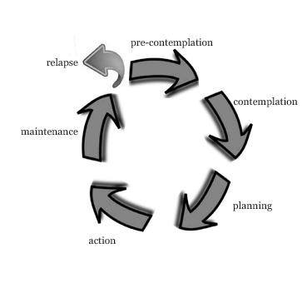

Type of Intervention → Stage of Recovery
Harm Reduction
“I don’t have a hoarding problem” + RISKS
Cognitive
BehaviouralTherapy
“Help – I want to change this”
- HIGH RISKS
[Prochaska & DiClemente, 1982; Miller & Resnick, 2013]

Slide 22


Assessing Readiness / Stage of Recovery
Asking the right question
Yes Is the client ready? No
Yes Is the client ready? No
What type of service will most support positive change?
What are they ready for?

Slide 23

Assessment: What type of service will help?
Today!
The Answer tells you how best to plan
Readiness Spectrum
Action…….…Preparation….…Contemplation……..Pre-Contemplation
CBT
Harm Reduction
Strategies overlap – in home visits, Ax/plan
Not static – expect change

Slide 24

Assessment = Where is my Client (today)?
The Answer tells you how best to help
PLAN
  Key Indicators:
Modifiers
?
CBT Skills Teaching
Harm Reduction
Safety & Eviction Risks
Good Insight & Motivation
Cognitive Functioning
Client Goals

Slide 25
Assessment = Where is my Client (today)?
The Answer tells you how best to help
PLAN
  Key Indicators:
CBT Skills Teaching
Harm Reduction
Safety & Eviction Risks
To Develop Plan:
Assess: what are the key safety concerns in this situation?
Safety & Eviction

Slide 26
Safety Risks: Assessment & Plan
Harm reduction in action
How to assess and intervene in situations of risk:
STEP 1: Protect Yourself
STEP 2: Safety Assessment
STEP 3: Prioritize service goals
STEP 4: Provide hands-on support

Slide 27
Safety Risks: Assessment & Plan
Harm reduction in action
How to assess and intervene in situations of risk:
STEP 1: Protect Yourself
STEP 2: Safety Assessment
STEP 3: Prioritize service goals
STEP 4: Provide hands-on support

Slide 28


Safety Risks – how can I assist??
Your safety is important too!
STEP 1: Protect Yourself
HOW?
Place personal belongings in garbage bag & seal
Protective equipment: gloves, boots, gown, mask
Avoid sitting
Locate exits/paths
Bring alcohol-based handrub
Wear PPE if required

Slide 29
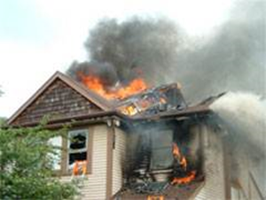
Safety Assessment:
Identify key areas of concern
STEP 2: Safety Assessment
  Clutter Image Rating Scale
  Health & Safety Checklist
  HOMES
  Environmental Cleanliness & Clutter Scale
  Home Environment Index
Fire

Slide 30
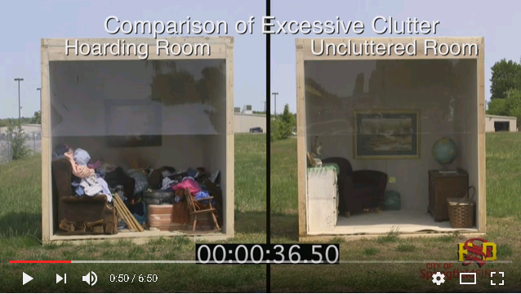
Safety Assessment
Fire risk: Volume of Clutter
Fires are Larger in Homes with Hoarding
Financial loss (av.)
Non-hoarding home = $12 500
Hoarding home = $100 000
Fires Contained to Room of Origin (av.)
Non-hoarding home = 90%
Hoarding home = 40%
https://www.youtube.com/watch?v=qy1h-vbmd78 40-1:47
[Harris, 2012. Household Hoarding and Residential Fires]

Slide 31

Clutter Image Rating Scale (CIR)
Frost, Steketee & Renaud, 2008
Series of 9 sequential pictures: bedroom, living room, bathroom, kitchen
Provides more objective measure of clutter volumes
Can be used to measure change – consider applying to specified location within room.
To use: select picture that most closely matches home conditions. Average out the total volume within the room.

Slide 32
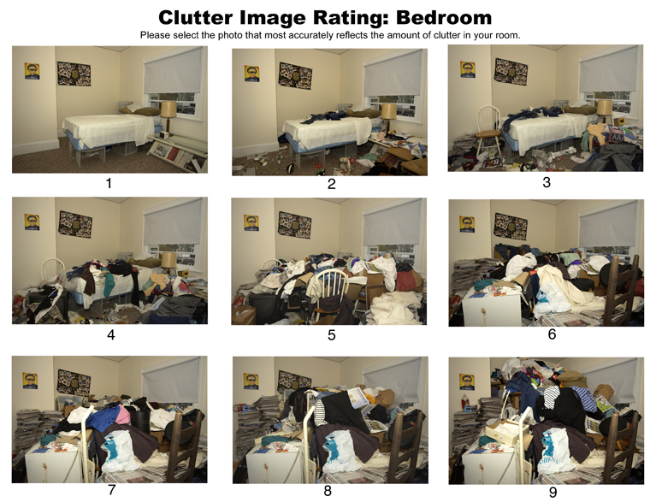
Assessment: Clutter Volume
Clutter Image Rating Scale: Frost, Steketee & Renaud, 2008
http://www.science.smith.edu/departments/PSYCH/rfrost/Hoarding_Images.htm
[Frost, Steketee, Tolin, Renaud, 2008]

Slide 33
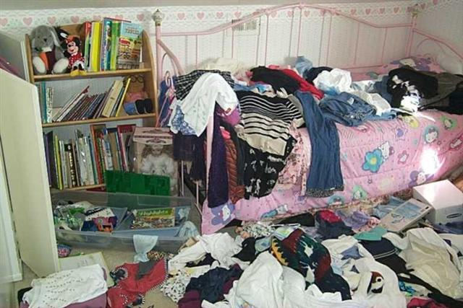
Clutter Image Rating Scale
Bedroom
4

Slide 34
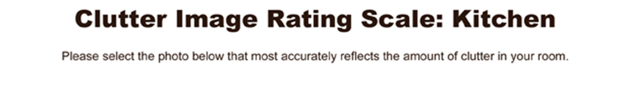
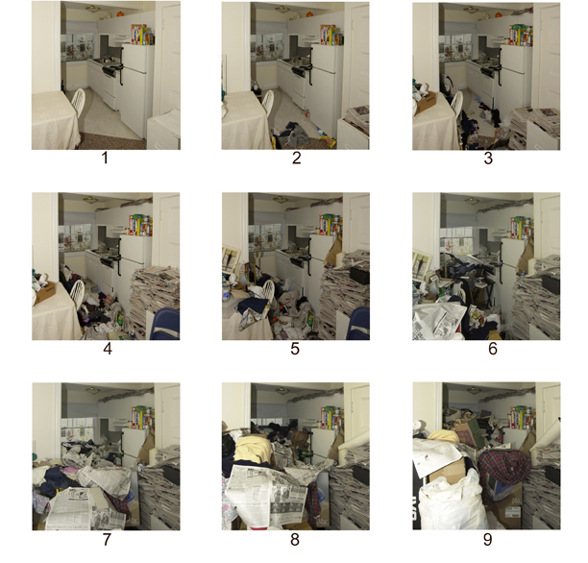
[Frost, Steketee, Tolin, Renaud, 2008]

Slide 35
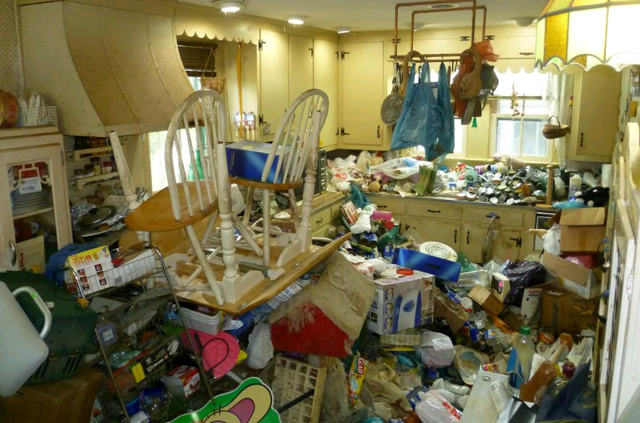
Clutter Image Rating Scale
Kitchen
6

Slide 36
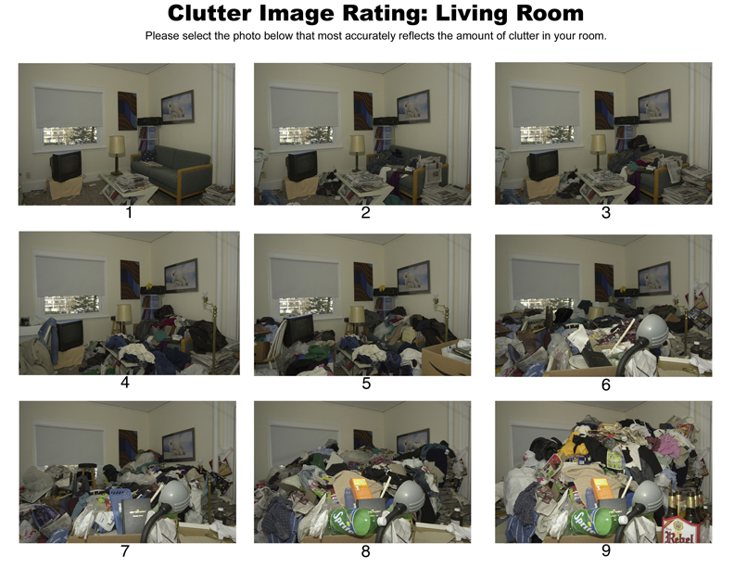
[Frost, Steketee, Tolin, Renaud, 2008]

Slide 37
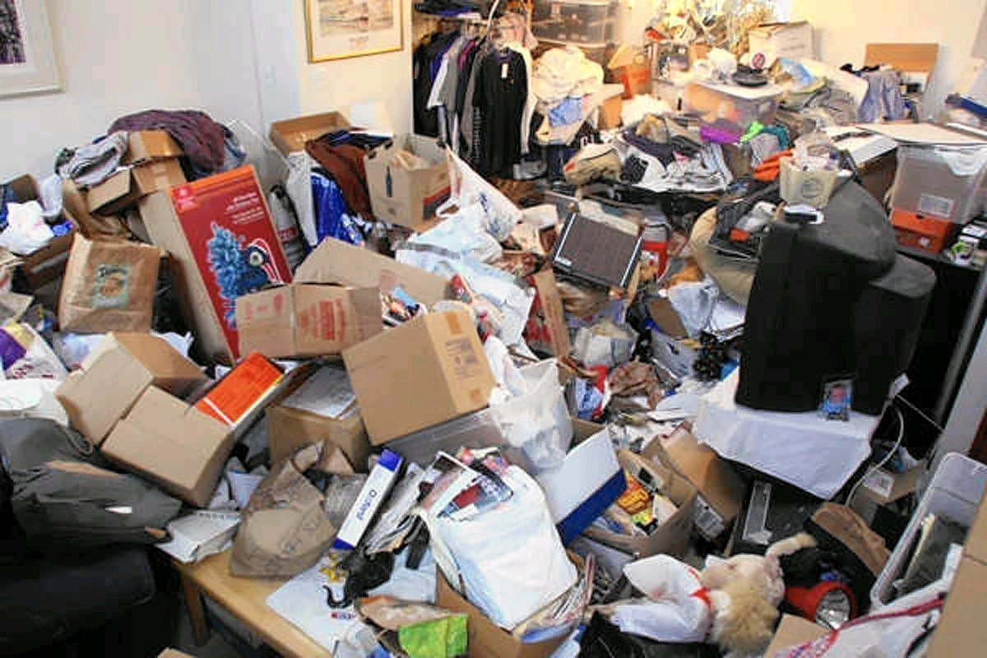
Clutter Image Rating Scale
LIVING ROOM
8

Slide 38
Safety Assessment: Fire
Identify key areas of concern
Typical Fire Safety Concerns with Hoarding:
A large volume of things which can burn
Blocked exits & hallways
Combustibles:
  near sources of heat (i.e. stove, radiator, exposed lightbulbs),
  open flames (i.e. candles, lighted cigarettes),
  on top of extension cords/electrical outlets
Unsafe cooking/heating practices because utilities or appliances are not working or inaccessible.

Slide 39

Fire Services
Inspect homes & assess fire safety
Fire services encounter hoarding:
Responding to emergencies
Safety inspections initiated by concerned family, landlords, neighbours and others.
Fire services have the authority to inspect private homes and rental units (with or without the permission of the occupant) and assess for fire safety.
Notes:
39

Slide 40
FIRE
Fire services can inspect a home and enforce fire code.
For example:
“the tenant shall not allow any activity or permit any condition to exist in the leased premises that may create fire or health hazard”
Breach of fire code can result in inspection orders, fines, court proceedings.
Notes:
40

Slide 41

Personal Health Information Disclosure
Without client consent
There is no legal duty to inform
    Moral/ethical & professional role
EXCEPT
Children – must be reported to CAS
Example of physical neglect: child’s need for food, clothing, shelter, cleanliness not adequately met

Slide 42


Personal Health Information Disclosure
Without client consent
Disclosure of vital and, in some cases,
life saving information is permitted
    “Reasonable and probable grounds that disclosure is necessary for purpose of eliminating or reducing significant risk of serious bodily harm to a person or group of persons”
Document: data, reasoning, consideration of risks to disclosure and non-disclosure

Slide 43

Safety Assessment – Identify Risks
Fire … Eviction ...Infestations …. unsanitary conditions …
Notes:
43
Situations of extreme clutter expose individuals, families, and communities to serious health and safety risks including homelessness, fire and infestation [Steketee, G., Frost, R.O., Kim, H.J., 2001. Hoarding by elderly people. Health and Social Work 26, 176–184]
Excess clutter is a substantial contributor to bedbug and other infestations, and can render pest control treatment ineffective [McDonald, L. & R. Zavys, 2009. Bed Bugs are Back. Woodgreen Community Services, Toronto.]
Extreme clutter can expose clients to falls, fires, floods, infestations, respiratory problems, and difficulty accessing emergency services.
Eviction and other court proceedings may result in homelessness, hospitalization or even an unwanted move into a long-term care facility [Damecour & Charron, 1998, Frost Steketee & Williams, 2000; Steketee & Frost, 2003; Thomas, 1997
Often people who hoard cannot heat or cool their homes because clutter blocks the heating or cooling vents. Their homes are often in disrepair because they will not let someone into their home to repair the roof, sink, or toilet because they are ashamed or because they fear discovery. About half of those who suffer from compulsive hoarding are unable to use their stovetops, refrigerators, tubs or sinks, and 1 in 10 is unable to use the toilet (Frost et al., 2000). They are at risk of slipping and falling in the clutter, which is particularly dangerous for frail, older adults. [Working With Families of People Who Hoard: A Harm Reduction Approach; Michael A. Tompkins, 2011].

Slide 44
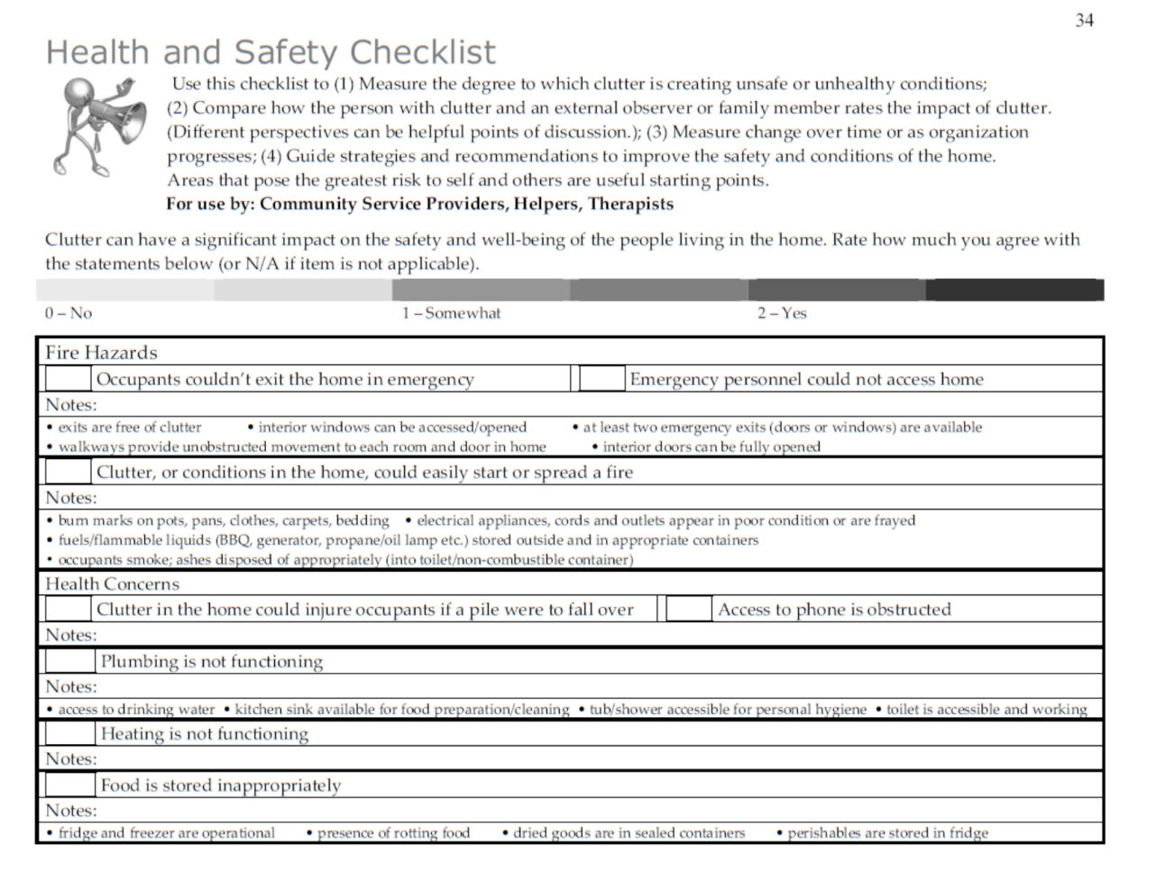
Health and Safety Checklist
VHA – community use
Assesses in home conditions that are typical concerns with hoarding safety.
To use: rate yes/no/somewhat
EMS access
Fire
Health
Plumbing, heating
Food storage
Garbage
Infestation
Falls
Children, vulnerable adults
pets
Screen for key areas of clinical goal setting.

Slide 45
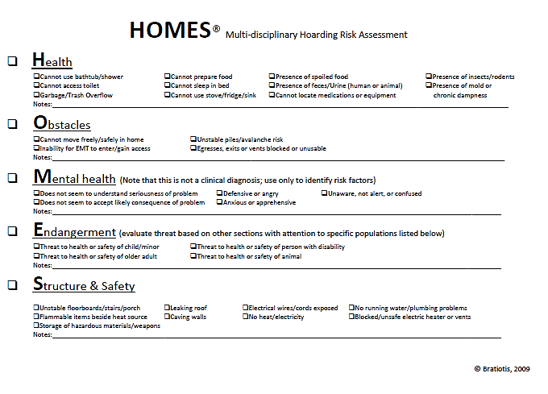
HOMES
Bratiotis, 2009
Assesses squalor conditions
Can be used to quantify risk for service personnel.
To use: Rate degree of each item 0-3
Accessibility
Accumulation of refuse/garbage
Accumulation of belongings
Cleanliness
Bathroom/toilet
Kitchen/food
Odour
Vermin
Sleeping area
Structural conditions/maintenance
Positive scores identify areas for goal setting.

Slide 46
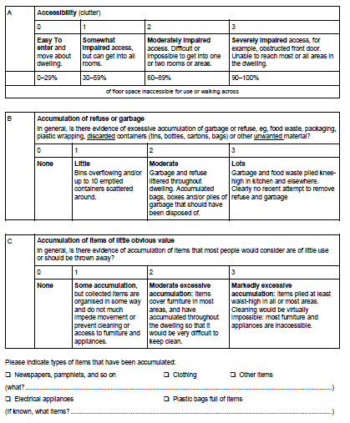
Environmental Cleanliness and Clutter Scale (ECSS)
Halliday & Snowdon, 2006
Assesses squalor conditions
Can be used to quantify risk for service personnel.
To use: Rate degree of each item 0-3
Accessibility
Accumulation of refuse/garbage
Accumulation of belongings
Cleanliness
Bathroom/toilet
Kitchen/food
Odour
Vermin
Sleeping area
Structural conditions/maintenance
Score >12 suggestive of moderate-severe hoarding.

Slide 47
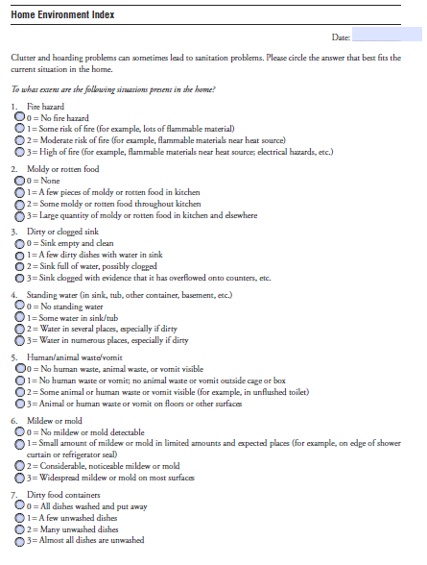
Home Environment Index (HEI)
Rasmussen, steketee, frost, tolin, brown
Assesses squalor conditions in the home.
To use: rate 15 items on 4 point scale
Fire hazards
Food
Skink
Water
Biohazard waste
Mold
Cleanliness & cleaning
Insects
odour
Scoring highlights areas of concern.

Slide 48


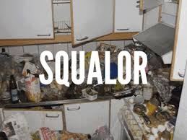
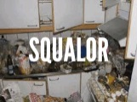
Is self-report accurate?
Sometimes…
Limited insight common: does not consistently = under-reporting:
Clutter Image Rating Scale:
Person with HD Indep. Rater Family
<
=
Frost et al, 2008,
DeMauro et al 2013
≤
Drury et al, 2015
Home Environment Index:
Person with HD Family
Drury et al, 2015, DiMauro et al 2013
<
[DiMauro, Tolin, Frost, Steketee 2013; JOCRD, 2:130-136; Drury et al, 2013, JOCRD, 5: 37-42]

Slide 49

Risks of Excessive Acquisition
Dsm-v Specifier
88%
Excess Acquisition* *past or current EA; 526 self ID hoarders;369-HD)
Acquisition of items not needed or for which there is no available space.
Buying, Free things, Stealing
ASSESS RISKS:
Clutter volume, debt, unpaid bills
[Frost, Rosenfield, Steketee, Tolin, 2013; An examination of excessive acquisition in HD, Journal of Obsessive Compulsive and Related Disorders, 2, 338-345]

Slide 50

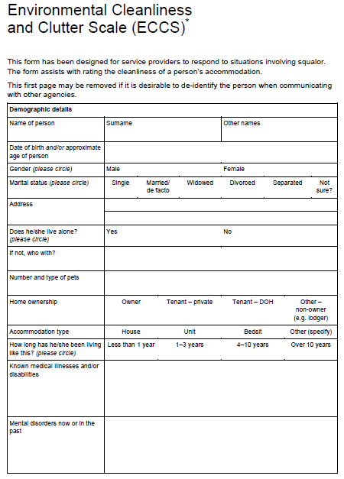
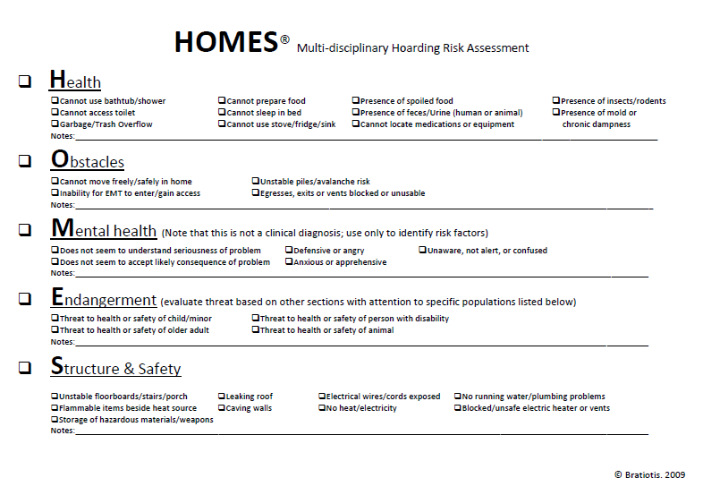
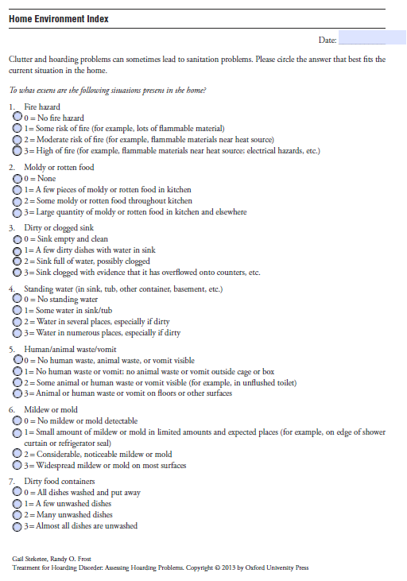
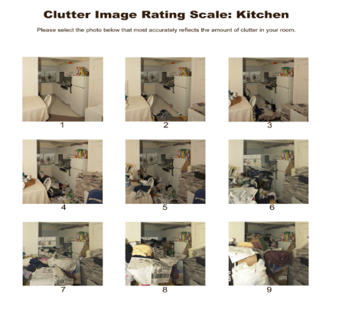
Safety Risks – how can I assist?
Harm reduction in action
STEP 1: Protect Yourself
STEP 2: Safety Assessment
STEP 3: Prioritize service goals
STEP 4: Provide hands-on support
WHY?
Assess level of risk
Educate your client about risks
Document any concerns
Assists to prioritize goals & service

Slide 51
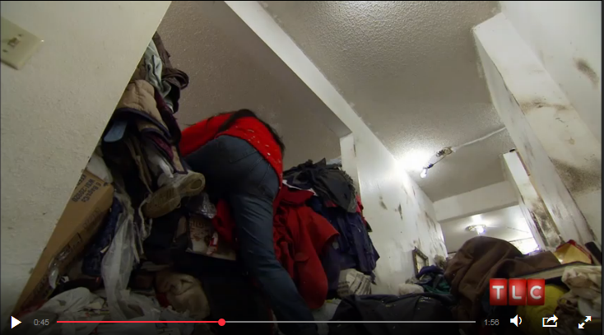

Practice: Assess this Situation
Hoarding buried alive: Gourmet kitchen
CBT Skills Teaching
Harm Reduction
http://www.tlc.com/tv-shows/hoarding-buried-alive/videos/gourmet-kitchen/

Slide 52

Safety Risks: Assessment & Plan
Harm reduction in action
How to assess and intervene in situations of risk:
STEP 1: Protect Yourself
STEP 2: Safety Assessment
STEP 3: Prioritize service goals
STEP 4: Provide hands-on support

Slide 53


Setting Realistic Service Goals
Harm Reduction in action
You can’t control outcome:
  Respond to the client, not responsible for the clutter
See success in small changes:
  Manage your own expectations for change
Connect with the goals of the client:
  “For the PSW to keep coming, here’s what would need to change for them to continue visits”
Teach skills & support; don’t take away the problem
Support clients to understand choice consequences:
“If you keep these newspapers in the hall, what do you think the landlord will do when she inspects the apartment next week?”
Notes:
Self management principles
Self-management education complements traditional patient education in supporting patients to live the best possible quality of life with their chronic condition. Whereas traditional patient education offers information and technical skills, self-management education teaches problem-solving skills. A central concept in self-management is self-efficacy—confidence to carry out a behavior necessary to reach a desired goal. Self-efficacy is enhanced when patients succeed in solving patient-identified problems.

Slide 54




Realistic SERVICE Goals:
Tip for Success: write your goals out in a plan
for client and all helpers!
Harm Reduction in action
The client will not fall again in the home.
The client & their support team will clear a 75 cm wide path on the stairs. The client will have access to a local handyman service to install handrails & add lighting in the stairwell.
The client will stop acquiring new things.
The client & their support team will discard all food that is rotten or beyond it’s expiration date.

Slide 55

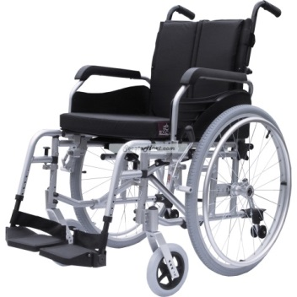
Manage Expectations
Hoarding Disorder :
Chronic, Complex,
Clutter slow to change
“We cleared things out just last year and prevented her from being evicted … now things are right back to where it was!”
Notes:
Hoarding disorder is known to be chronic and progressive. Managing expectations for change is critical!!!
Unlike depression, for example in which the average episode lasts for a few months & resolves (though seom symptoms may be residual)
Use example of MS, heart disease etc

Slide 56

Manage Expectations
Realistic goals
Clients are learning to sort, make decisions, and manage feelings associated with discarding.
Collaborative work with hoarding clients can move at a glacial pace.
Organizing and de-cluttering can take a year or even longer.
.
Bratiotis et al, The Hoarding Handbook. Oxford University Press, p163. 2011
Notes:
Hoarding disorder is known to be chronic and progressive. Managing expectations for change is critical!!!
Use example of MS, heart disease etc

Slide 57
Safety Risks: Assessment & Plan
Harm reduction in action
How to assess and intervene in situations of risk:
STEP 1: Protect Yourself
STEP 2: Safety Assessment
STEP 3: Prioritize service goals
STEP 4: Provide hands-on support

Slide 58
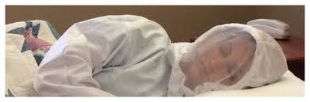

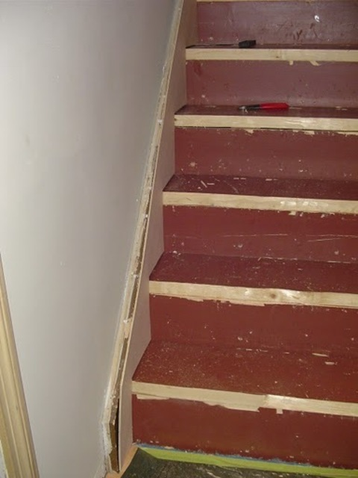
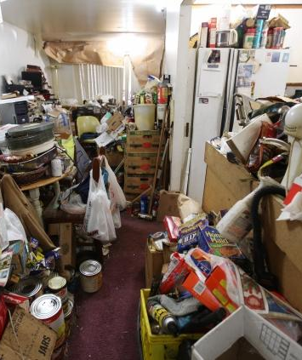




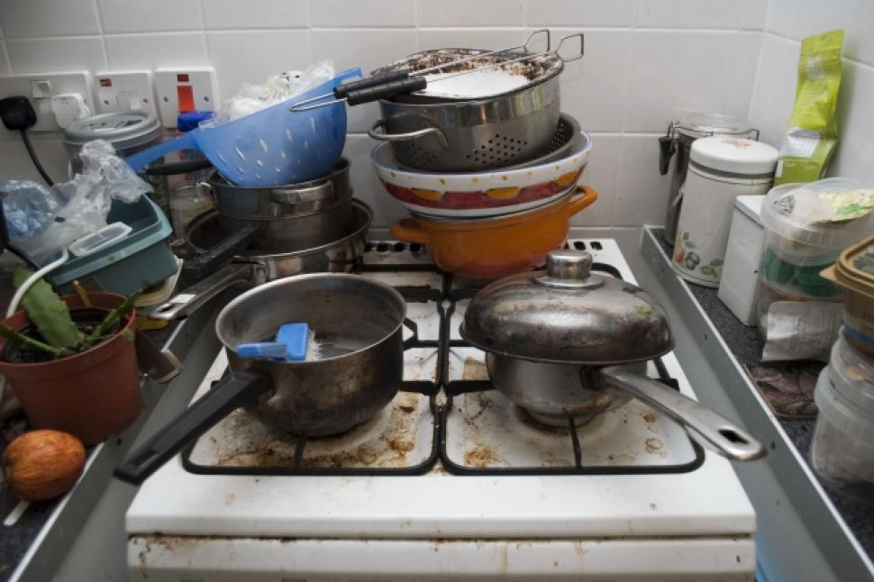
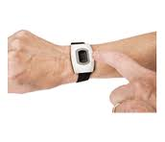
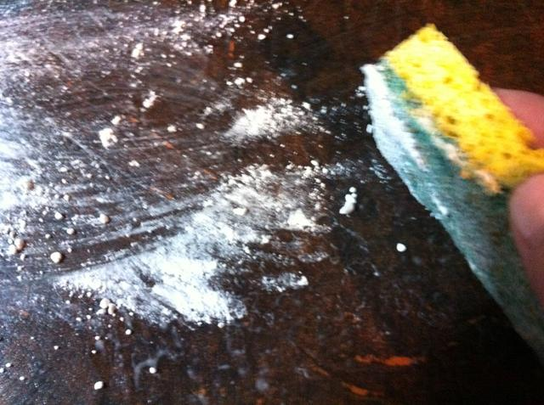
Harm Reduction -Reduce Safety Risks
Strategies Without focus on discarding

Slide 59
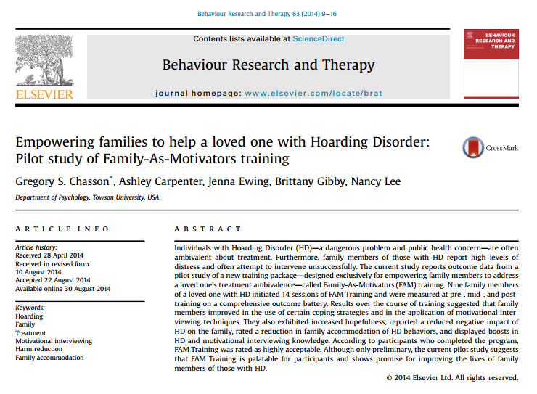

Hands-on, in-home
A difficult hole to fill: time, cost intensive
YOU!
Assess Support Options:
What could be funded?
What type of physical support needed to lift, move etc.?
What type of supports does the client already have?
Creativity Needed - Volunteers, PSWs, Mental health workers, organizers; Coached Friends, family, community groups (FAM training)

Slide 60
Harm Reduction – Clutter Impact
Realistic outcomes

Slide 61

Hands-on Support in the Home
Sorting with the 3-S Technique
Set-Up:
Pick a place to start & gather materials
Sort:
Decide if the item is Keep or Out:
create categories
Store:
Put things away immediately
Notes:
See also:
Paper can be sorted with the ‘ABC’ technique (p. 54)
Structure the organization sessions with a planned agenda
(pg. 57)

Slide 62
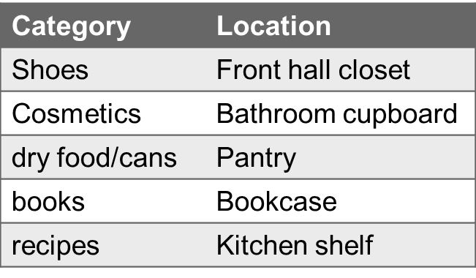
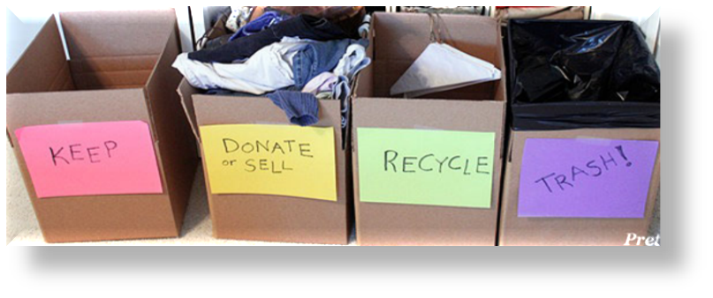
Hands-on Support in the Home
Sorting with the 3-S Technique
Set-Up:
Pick a place to start & gather materials
Sort:
Decide if the item is Keep or Out:
create categories
Store:
Put things away immediately
Notes:
See also:
Paper can be sorted with the ‘ABC’ technique (p. 54)
Structure the organization sessions with a planned agenda
(pg. 57)

Slide 63

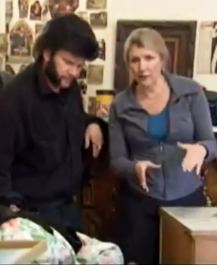
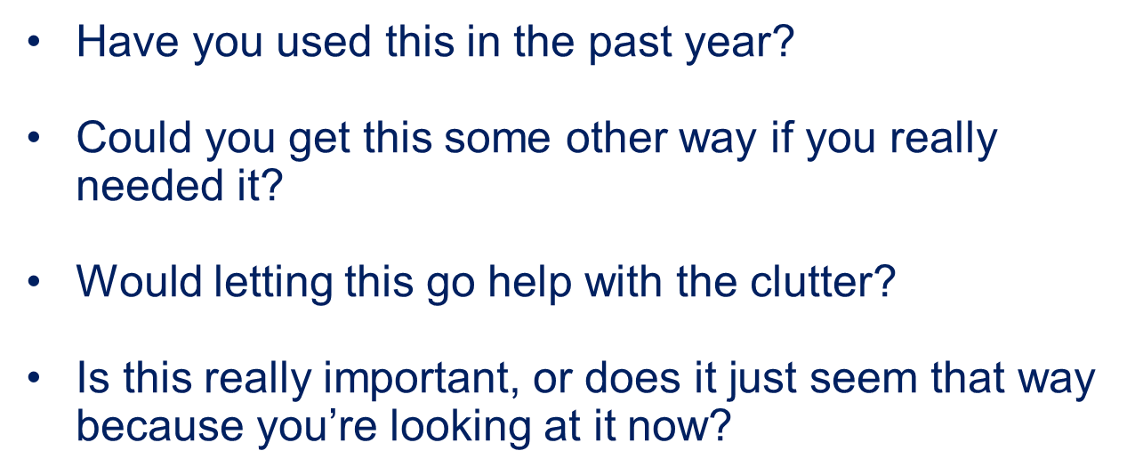
Hands-on Sorting Assistance:
Establish Ground rules with client
Only touch things with client’s permission
The client makes all final decisions
Support client to stay focused
Have client speak aloud thoughts as they sort
Be encouraging: recognize small gains
Support with decision-making: questions

Slide 64


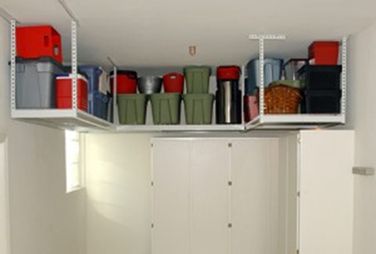





Hands-on Support in the Home
Sorting with the 3-S Technique
Set-Up:
Pick a place to start & gather materials
Sort:
Decide if the item is Keep or Out:
create categories
Store:
Put things away immediately. Undecided. Garbage/donation/sell. Re-organize.
Notes:
See also:
Paper can be sorted with the ‘ABC’ technique (p. 54)
Structure the organization sessions with a planned agenda
(pg. 57)

Slide 65


Hands On Assistance
What do you notice the coach doing?
CBT Skills Teaching
Harm Reduction
A&E Hoarders Buried Alive; Mar 9 2011; Order out of Chaos
http://www.youtube.com/watch?v=XiafdkzpbeE

Slide 66



What about Extreme Cleanouts?
Not generally effective for hoarding
Does not address behaviours that create clutter.

Slide 67

Not all Clutter is Hoarding Disorder
Hoarding as a Symptom for other Disorders
Hoarding Disorder
Dementias
Acquired Brain Injury
Diogenes
Parkinsons
Huntingtons
Prader Willie Syndrome
Autism Spectrum Disorders
Frailty, Depression, Vision…
Petrusa et al 2011; Frost et al 2011;

Slide 68




Assessment of Hoarding Disorder
Several standardized tools available
In the field:
Select a specific pile, ask which objects could be discarded right now.
Clinical Ax: SI-R, HRS, SIDH, UHSS

Slide 69


What about Extreme Cleanouts?
Not generally effective for hoarding, except…
Optimize: collaborate with Client, respect the home’s contents, set up keep boxes/areas, consider appointing surrogate decision-maker, use clear garbage bags
Collaborative, client-driven removal once discard skills well integrated.
Safety risks far outweigh risks of cleanout

Slide 70
Assessment = Where is my Client (today)?
The Answer tells you how best to help
PLAN
  Key Indicators:
CBT Skills Teaching
Harm Reduction
Safety & Eviction Risks
To Develop Plan:
Assess: what are the key safety concerns in this situation?
Safety & Eviction

Slide 71
Eviction
Notes:
In study of hoarders, Eight to 12% had been evicted or threatened with eviction due to hoarding [The economic and social burden of compulsive hoarding David F. Tolin, Randy O. Frost c, Gail Steketee d, Krista D. Gray e, Kristin E. Fitch, 2008]
Residential Tenancy Act: rental housing in Ontario
N5: interference with reasonable enjoyment of residence by others/ willfull or negligent damage of the rental unit (7 days, then landlord can apply to Landlord/Tenant Board for eviction)
N7: condition of residence impairs safety of tenant (10 days → Landlord/Tenant board application for eviction)
AND
Municipal Property Standards
Inspectors identify bylaw infractions and can issue Notices of Violation (NOV – informs occupant of a problem) or Order Comply (occupant to address issue –may be fined otherwise). Inspectors cannot enter the premises without the consent of the occupant.
Sample bylaws: every person who occupies property shall:
-maintain the property in a clean and sanitary condition
-keep all exits clear and unobstructed
-cooperate with the landlord in complying with the requirements of bylaws
-maintain sanitary conditions
etc
BUT
Ontario Human Rights Code
Human Rights Code is paramount to the Residential Tenancies Act or Municipal Acts and the landlord's obligations under the Code must first be examined and exhausted prior to attempts at termination of a tenancy.
-Landlords must make efforts to accommodate the tenant's inclusion of 14 protected groups to the point of undue hardship. Undue hardship has been defined as being costs so substantial that they permanently and materially impair the viability, the very existence of the commercial enterprise (I.e. to the point just short of bankruptcy).
-protected groups include race, ethnicity, religion, physical and mental disability, sexual orientation, receipt of public assistance and family composition etc
- if the tenant's inclusion in one or more of the 14 protected groups makes it difficult to comply with rental agreements, then landlords need to work with the tenant in the "shared responsibilities of accommodation" to try and bring the behaviour or environment to a point so that the tenant is not excluded from the full participation and inclusion in normal living. The landlord needs to assist in the accommodation process so as to remove the risk of the tenant losing their housing.

Slide 72
Eviction – How can I assist?
Harm reduction in action
STEP 1: Be informed
STEP 2: Educate client & Advocate
STEP 3: Prioritize goals
STEP 4: Provide hands-on support

Slide 73
Eviction – How can I assist?
STEP 1: Be informed
KNOW THE LEGISLATION
    Residential Tenancy Act
    Ontario Human Rights Code
    Legal Aid
    Property standards

Slide 74

Residential Tenancies Act
Eviction notices issued for hoarding
Notice to Terminate a Tenancy Early
willfully or negligently damaged the rental unit or the complex
substantially interfered with the reasonable enjoyment of the landlord or another tenant.
The tenant of the rental unit has seriously impaired the safety of another person.
Notes:
Hoarding is not permitted by the Residential Tenancies Act nor condoned by the Board. The problem is that the Human Rights Code is paramount to the Residential Tenancies Act and the landlord's obligations (and the tenant's obligations) under the Code must first be examined and exhausted prior to attempts at termination of a tenancy. If a provision of the Residential Tenancies Act is inconsistent with the Code, that provision has no force or effect.
landlord having to prove that they have made efforts to accommodate the tenant's inclusion in a Code-related ground (usually disability) to the point of undue hardship. Undue hardship has been defined as being costs so substantial that they permanently and materially impair the viability, the very existence of the commercial enterprise. In other words, to the point just short of bankruptcy.
If a tenant fits into one of 14 protected groups under the Code, and you are providing accommodation to them, then you may have a duty to accommodate. These protected groups include but are not limited to race, ethnicity, religion, physical and mental disability, sexual orientation, receipt of public assistance and family composition.
But if the tenant's inclusion in one or more of the 14 protected groups makes it difficult to comply with the apparently neutral requirement or policy, then landlords need to work with the tenant in the "shared responsibilities of accommodation" to try and bring the behaviour or environment to a point so that the tenant is not excluded from the full participation and inclusion in normal living. The landlord needs to assist in the accommodation process so as to remove the risk of the tenant losing their housing.
Accommodation is working with the tenant, their supports, family, sources of outside funding, professionals etc. so that the tenant and their behaviour is elevated to a level where the problem no longer affects the enjoyment or safety of others. The effort and length to which the landlord must strain to help the tenant achieve that level is "the point of undue hardship". If the landlord's efforts fail despite having reached the level of undue hardship, then the tenant may be evicted and the landlord absolved of further responsibility
Human Rights Commission's policy guideline on Human Rights in Rental Housing

Slide 75

Pick a Place to Start
Risks to housing stability
Common Eviction Concerns:
Fire risks
Infestations
Odor, cleanliness
Damage to structure, appliances
Landlord/maintenance access to exits, appliances, heating
Pets unmanaged
Rent not paid
Common Bylaw Infractions (Rural):
Garbage unmanaged
Lawn unkempt
Pets
Debris on lawn
Structural damage to home

Slide 76

Residential Tenancies Act
Bedbugs
Harry Fine, “Ontatrio Landlord and Tenant Law Meets Bed Bug Crisis”; online:
http://www.peelregion.ca/health/environnew/pdf/fine.pdf

Slide 77

Human Rights Code
Hoarding as a disability
Landlords must work with tenant in "shared responsibilities of accommodation“
DUTY TO ACCOMMODATE:
Ex: contact community supports, provide organization and clutter removal services, short-term tolerance of moderate health & safety concerns, tolerating a degree of unkemptness.
To the point of “undue hardship.”
The greater the resources of the landlord, the more involved the accommodation measures must be.
Human Rights Commission policy guideline on Human Rights in Rental Housing:
www.ohrc.on.ca
Blum, L. 2013. Buried Alive: The Human Rights implications of Compulsive Hoarding in the Landlord-Tenant Context. Canadian Journal of Poverty, 2:2 C.J. Poverty Law.

Slide 78
Eviction – How can I assist?
STEP 1: Be informed
STEP 2: Educate client & Advocate
    Options & consequences:
      Do nothing –eviction likely
      Appeal eviction (legal support)
      Identify specific reasons for eviction and/or key safety risks: address these/ negotiate with landlord

Slide 79

Legal Aid
Involve early in process (before N5 or N7)
Assist client with Landlord & Tenant Board
  Duty to Accommodate: adjournment, interim orders; mediated agreements
Adjudicators typically seek change in clutter conditions over a period of a few months.

Slide 80
Advocate for your Client
Work with landlord for accommodation
Establish the existence, seriousness & impact of a disability:
  obtain diagnosis
  impact symptoms have on maintaining environment
Support / arrange efforts for intervention:
  Tenant to demonstrate they are an active part of the accommodation process
Harry Fine, “Thoughts on Ontario Residential Landlord and Tenant Law, 2010; online: http://landlord-law-ontario.blogspot.ca/2010/11/hoard-and-bedbugs-and-fires-and-mental.html

Slide 81
Advocate for your Client
Work with landlord
Educate the landlord about their need for accommodation
  “Buried Alive: the Human Rights Implications of Compulsive Hoarding in the Landlord-Tenant Context”. Laren Blumas, JD Osgoode Law School.
  OCfoundation.org Hoarding Fact Sheet:
  DSM-5 Criteria
Harry Fine, “Thoughts on Ontario Residential Landlord and Tenant Law, 2010; online: http://landlord-law-ontario.blogspot.ca/2010/11/hoard-and-bedbugs-and-fires-and-mental.html

Slide 82
Eviction – How can I assist?
STEP 1: Be informed
STEP 2: Educate Client
STEP 3: Prioritize goals
  Identify & address specific reasons for eviction
Clearout kitchen → keep all flammables 30cm from stove; do not store items in oven
Declutter living room → clear 1m pathway to back exit, remove items within 1m of radiators.

Slide 83


Eviction – How can I assist?
STEP 1: Be informed
STEP 2: Educate client & Advocate
STEP 3: Prioritize goals
STEP 4: Provide hands-on support

Slide 84
Assessment = Where is my Client (today)?
The Answer tells you how best to help
PLAN
  Key Indicators:
modifiers
CBT Skills Teaching
Harm Reduction
Safety & Eviction Risks
Good Insight & Motivation
Cognitive Functioning
Client Goals
Safety & Eviction Risks
Good Insight & Motivation
Cognitive Functioning
Client Goals
Modifiers:
Anticipate occurrence
Assess by observation as you implement plan

Slide 85

Refine Implementation Plan
Assess for modifiers
Prioritized Service Goals/Plan
(Safety & Eviction Prevention)
+ Limited Insight & Motivation
Refine plan to include motivational strategies
Reduce pace & expectations around goals

Slide 86
Insight – Often Described as Limited
Recognition that hoarding beliefs/behaviours are problematic
Insight in Community Sample:
Treatment for HD:
Less likely to seek
High drop-out
Passive resistance
(e.g. no homework)
Motivation fluctuates
(→ belief that Tx does not work)
Why? Ego-syntonicity
+ Low Insight
Frost, Tolin, Maltby (2010). Cog Behav Practice, 17: 404-413

Slide 87
Assessing Insight & Motivation
Observe behaviour throughout plan implementation
Limited Insight:
Anasognosia
Over-valued beliefs
Defensiveness (reactance)
Motivation:
Readiness Ruler – specific goals

Slide 88


Motivation
Readiness ruler
How important is it to keep all flammables 30cm from stove?
How confident are you that you can remove all items within 1m of radiators?

Slide 89

Assessing Limited Insight
Anasognosia | over-valued ideation | defensiveness
Anasognosia:
Not knowing there is a problem
    Lacking awareness of problem severity
    Indifference to consequences of hoarding
    More likely to interact with community providers than outpatient clinics
  Blue black is white gold ??
  AVOID TEMPTATION TO DEBATE
  Build discrepancy to support client to draw their own
  conclusions (where life is vs. where would like to be)
Frost, Tolin, Maltby (2010). Cog Behav Practice, 17: 404-413
Therapeutic relationship

Slide 90
How to address Anasognosia
Build discrepancy
Client: My landlord treats me like a child. He just comes by and judges me, threatens me!
Therapist: Meetings with him have been pretty upsetting, eh?
Client: Yeah, they are.
Therapist: What do you think would make him treat you differently?
Client: If he drops the eviction and just leaves me alone!
Therapist: And if he drops it, things will go back to normal?
Client: Yes, and I can get on my with life. I’ve had to put things aside to deal with all this. It’s a distraction, and unneeded one!
Therapist: From the sounds of it, he’s not likely to drop it, eh?
Client: No.
Anasognosia:
  Build discrepancy to support client to draw their own
  conclusions (where life is vs. where would like to be)
Frost, Tolin, Maltby (2010). Cog Behav Practice, 17: 404-413

Slide 91

Meet Rick …
Housing Instability
CBT Skills Teaching
Harm Reduction
https://www.youtube.com/watch?v=olKtz189oCk

Slide 92
Assessing Limited Insight
Anasognosia | over-valued ideation | defensiveness
Over-Valued Beliefs
2. Thoughts about possessions so tightly held can appear delusional
    Range from mild to extreme
    Sentimental/Instrumental/Intrinsic
  Example: Aunt’s 300+ Cookbooks = identity as a good cook/mother, dream of having grandchildren over for holiday dinners, connection to deceased aunt.
  AVOID (1) PRESENTING RATIONAL ARGUMENTS OR
  (2)TELLING CLIENT TO DISCARD TO DECLUTTER.
  Support client to test beliefs with
  Behavioural Experiments
Frost, Tolin, Maltby (2010). Cog Behav Practice, 17: 404-413

Slide 93


Addressing Over-valued Beliefs
Behavioural experiments
Over-Valued Beliefs
CBT Skills Teaching
Harm Reduction
  Support client to test beliefs with
  Behavioural Experiments
Frost, Tolin, Maltby (2010). Cog Behav Practice, 17: 404-413

Slide 94
Assessing Limited Insight
Anasognosia | over-valued ideation | defensiveness
“Defensiveness”
3. Perception that personal will is being imposed upon
    Presents as argumentativeness, frustration (client/therapist)
    Therapeutic reactance: motivation to restore personal freedom perceived to have been threatened/lost
    Maintaining control over possessions
AVOID PRESENTING REASONS TO DECLUTTER;
OR ISSUING DIRECTIVES
  Demonstrate to client they are in control.
Frost, Tolin, Maltby (2010). Cog Behav Practice, 17: 404-413
Notes:
Start with supporting idea that beliefs are hypothesis to be tested. Beliefs might contribute to problem and alternative beliefs might be just as valid. Test – not with purpose of habituation, but with providing information to confirm or disprove belief. Explore outcome with client, re-inforce eg by cooking without cookbooks at meals to go

Slide 95
Addressing Defensiveness
Client retains therapeutic control
“Defensiveness”
All sorting decisions are theirs, ask permission to touch things, set goal to create living space (vs. declutter), provide choices (do this or that now?),
let go of personal agenda for change
  Demonstrate to client they are in control.
Frost, Tolin, Maltby (2010). Cog Behav Practice, 17: 404-413
Notes:
Start with supporting idea that beliefs are hypothesis to be tested. Beliefs might contribute to problem and alternative beliefs might be just as valid. Test – not with purpose of habituation, but with providing information to confirm or disprove belief. Explore outcome with client, re-inforce eg by cooking without cookbooks at meals to go

Slide 96
Assessment = Where is my Client (today)?
The Answer tells you how best to help
PLAN
  Key Indicators:
REFINERS
CBT Skills Teaching
Harm Reduction
Safety & Eviction Risks
Good Insight & Motivation
Cognitive Functioning
Client Goals
Modifiers:
Anticipate occurrence
Assess by observation as you implement plan

Slide 97

Cognitive Functioning
Assess by Observation
Attention
Memory (visual)
Categorization
Decision-making:
Neurocognitive impairments key factor in the onset and maintenance of hoarding.
Photo: www.sheknows.com/home-and-gardening/articles/801870/important-questions-to-ask-when-hiring-a-professional-organizer
[Woody et al, 2014. ClinPsychol Review, 34: 324-336; Gilliam & Tolin, 2010]
Notes:
97

Slide 98
Refine Implementation Plan
Assess for modifiers
Prioritized Service Goals/Plan
(Safety & Eviction Prevention)
+ Impaired Cognitive Functioning
Refine plan to include organizational supports
Reduce pace & expectations around goals

Slide 99


Assess Decision-Making
observe discard decisions; Details, perfectionism
Iowa Gambling Task
No impairment observed: complex decision-making.
Global indecisiveness likely not specific feature of HD.
Sorting: Longer to decide, more anxiety, activation of regions in brain associated with emotional regulation. Effect greater with own papers.
Tolin,Kiehl,Worhunsky, Book, & Maltby, 2009; Tolin et al., 2012

Slide 100


Strategies for Decision-Making: Thought Listing
Emotional regulation via distancing
Cognitive re-appraisal may not be the most effective ingredient in CBT for HD; neural regions required for re-interpretation may be impaired.
Distancing via thought listing: describe aloud thoughts
about discarding with no effort to modify them
Frost et al, Behav Res Ther, 2016; 85:13-22.Adams et al, 2015, Behav Ther, 38(4): 87-97

Slide 101

Strategies for Decision Making: Practice
Tolerating the distress of discarding or making decisions

Slide 102














Assess Categorization
Under-inclusive grouping – collaborate on categories
Hoarding: longer, more piles, distressing
Luchian et al.,2007; Wincze et al, 2007; NOT Grisham et al 2010
Clinically significant visual categorization impairment observed:
Delis-Kaplan Executive Function System – sorting test
[Mackin et al, 2016, Depr & Anx, 33:211-218]

Slide 103


Assess Memory Beliefs
memory confidence AND impairment
Worry about forgetting information, events, relationships:
rely on objects to serve as memory aid
Items not put away into storage.
  Strategies for Memory Confidence:
  Lets try putting this into the drawer, I’ll write it down & we can see if next week you remember what we put there?
  List of contents
  Clear plastic bags, bins
Brief Visual Memory Test:
Research Inconsistent: possible visuospatial memory impairment
Frost & Hartl, 1996; Tolin et al 2011, Moody et al 2014; Mackin et al, 2016, Depr & Anx, 33:211-218]

Slide 104
Assess Attention
Difficulty with sustained attention
Robust relationship between ADHD and hoarding: ~28% meet ADHD criteria
Self-report high levels of inattentiveness
Research suggests possible visual attention impairment
Observe Client:
Difficulty staying on task during session, easily distracted, tangential, overly-inclusive speaking style
Strategies: Redirect & Focus:
“How about we finish this bag of shoes before
moving on…”
“Margaret, let me interrupt you here… I only have a limited time to help and I really want to see you succeed with your organizing… do you want to store these shoes in the closet or front hall?…“
Tolin & Villavincencia, 2010; Frost et al 2011; Moody et al, 2014

Slide 105

Assess: age
More likely to have cognitive difficulties
Elders who Hoard:
More risks: safety & eviction
Comorbidities: physical & psychiatric
ADLs impaired
Cognition impaired
Cognitive Rehabilitation
Ayers et al, 2015

Slide 106
Assessment = Where is my Client (today)?
The Answer tells you how best to help
PLAN
  Key Indicators:
REFINERS
CBT Skills Teaching
Harm Reduction
Safety & Eviction Risks
Good Insight & Motivation
Cognitive Functioning
Client Goals
Modifiers:
Anticipate occurrence
Assess by observation as you implement plan

Slide 107


Assessment - Functional Goals
Link service goals to client’s goals
Client’s values, dreams and goals.
What drives motivation to for a livable space?
ADL-H measure impairment in key functional domains.
[Frost et al 2013]

Slide 108
Focus on Specific Area of Home
Client-driven Goal setting
Start with the easiest changes
Garbage, items with least perceived value
Clear a place to make room for organizing activities
Clear off the back porch so recycling can go out
Clear off the dining room table for a sorting space
Choose something that impacts daily activities
Organize the front hall so its easier to get in the door
Clear out the kitchen sink to be able to prepare a meal

Slide 109
Focus on Specific Area of Home
Client-driven Goal Setting
Identify an area that will facilitate other goals
  Clear around the bed so that the PSW can assist with the transfer
  Sort through the dining room so as to be able to start having family over for the holidays
Pick objects of a particular theme
  Collections, toiletries, toys, etc
Choose objects that will make for visible changes
  Bulky items like furniture, bedding
  If not Safety Risk …Start Anywhere! – there is no wrong place (but pick one place and stick to it)

Slide 110


Acceptability of Hoarding Services
Perception that treatment is agreeable, palatable or satisfactory
More acceptable if:
personalized
being held accountable
(goals, home visits)
belief that treatment
works
Tip for Success: personalize your plan!
Tip for Success: leverage the visitor effect!
Tip for Success: advertise successes!
Innovators!
More acceptable options needed.
Rodriguez et al, 2016, JOCRD, 11: 1-8]

Slide 111
Assessing Readiness / Stage of Recovery
Asking the right question
Yes Is the client ready? No
Yes Is the client ready? No
What type of service will most support positive change?
What are they ready for?

Slide 112
Assessment: What type of service will help?
Today!
The Answer tells you how best to plan
Readiness Spectrum
Action…….…Preparation….…Contemplation……..Pre-Contemplation
CBT
Harm Reduction
Some overlap; Not static;

Slide 113
Assessment = Where is my Client (today)?
The Answer tells you how best to help
PLAN
  Key Indicators:
Modifiers
?
CBT Skills Teaching
Harm Reduction
Safety & Eviction Risks
Good Insight & Motivation
Cognitive Functioning
Client Goals

Slide 114
Today’s Objectives
Here’s where we have been
By the end of this session:
Name two main types of approach to treating Hoarding Disorder (HD)
(What can be done to help)
List an assessment tool to identify key safety/eviction risks and preferred Tx approach
(What to assess for so as to know how to best help)
Identify one strategy (or more!) to set up and address your plan of service.
(How you can develop a plan to help based on your assessment)

Slide 115


Thank You!
VHA Home HealthCare (VHA)—a not-for-profit charity—has provided care since 1925. With over 1,800 staff and service providers VHA offers home and community services that support Ontarians’ independence including: homemaking, nursing, personal support and rehabilitation services.
VHA is:
Accredited with Exemplary Standing by Accreditation Canada
An RNAO Best Practice Spotlight Organization candidate and;
A founding member agency of United Way Toronto.
www.vha.ca

