Slide 1
Animal Hoarding:
An Interface between Mental Illness and Animal Suffering
Linda Jacobson DVM PhD
Deputy Director: Shelter Medicine
Toronto Humane Society

Slide 2
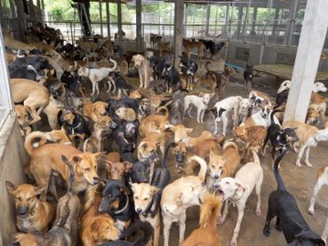
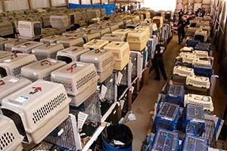

Slide 3
Definition
More than the typical number of companion animals
Inability to provide minimum standards of care (nutrition, sanitation, shelter, veterinary care)
Denial of this inability and its impact on the animals and humans involved

Slide 4
A Neglected Problem
“A neglected problem at the intersection of psychiatry, veterinary medicine, and law.” (Patronek)
Historically has “fallen between the cracks” of different disciplines and been “siloed” as an animal issue

Slide 5
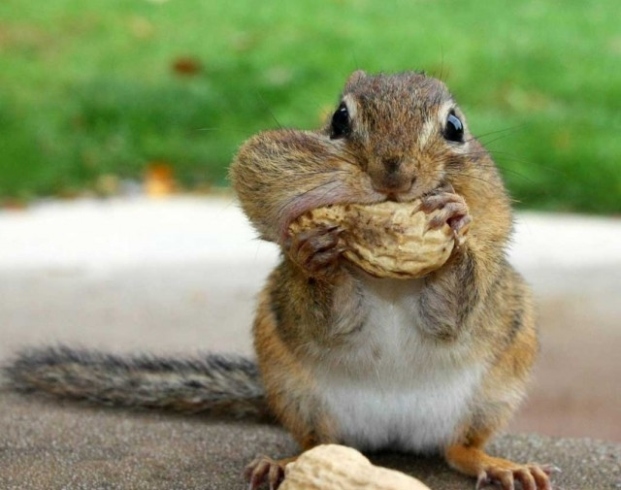
Pubmed: “Animal hoarding”
Notes:
43/69 hits- animals that carry out hoarding behaviours
5 research papers about people who hoard animals (2 overlap)
Photo https://colleenanderson.files.wordpress.com/2015/01/squirrel-e1334178089997.jpg

Slide 6
Research studies (humans)
Hoarding of animals: an under-recognized public health problem in a difficult-to-study population 1999 [54 case reports]
Health implications of animal hoarding 2002 [71 case reports]
Recognizing Diogenes syndrome: a case report 2014. [Single subject, HD?]
Hoarding animals in obsessive-compulsive disorder 2015 [2/420 OCD subjects]
Characteristics of persons convicted for offences relating to animal hoarding in New South Wales 2015 [29 subjects]

Slide 7
Main source, main gap
Hoarding of Animals Research Consortium 1995-2006 (Frost, Steketee, Nathanson, Patronek and others) - https://vet.tufts.edu/hoarding/
There are NO published studies of psychological or psychiatric evaluations of animal hoarders

Slide 8
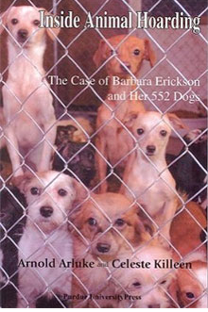
How common is it?
Minimal data
10-918 animals; median 39, average 56
80% involved cats, 55% dogs – any species can be involved
US – estimated 700-2,000 cases per year, up to 250,000 animals (1999)
[Patronek 1999]
Notes:
Patronek 1999

Slide 9
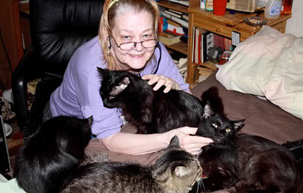
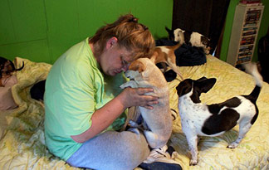
Typical demographic
Middle-aged or older unmarried woman
Often well-educated
May have a care-giving background
All income levels but often on disability, retired or unemployed

Slide 10
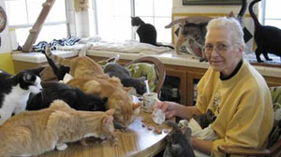
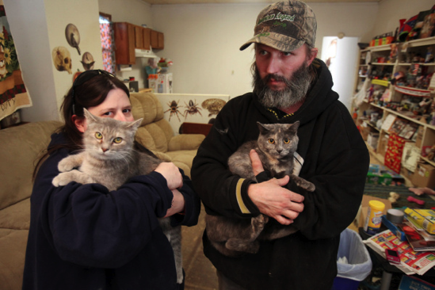
Animals take up most of their time and money
Often little contact with others, socially isolated
Some believe they have a special ability to communicate with animals
They believe they are helping the animals and that they love them
Profound lack of insight
Notes:
http://abcnews.go.com/Nightline/animal-hoarders/story?id=11206917

Slide 11
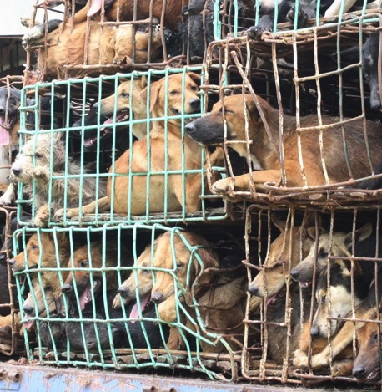
“Exploiter hoarder”
Sociopathic tendency
Generally financial motivation
Some puppy mills, “rescues”
The worst group for intervention and prosecution
Least common
Notes:
http://www.psychiatrictimes.com/addiction/hoarding-animals-update/page/0/1
http://www.royalflushhavanese.com/Puppy_Mill.php#.V_5ywyOANBc

Slide 12
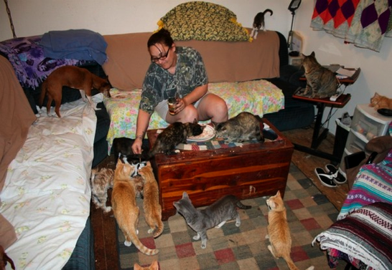
“Overwhelmed caregiver”
Passive acquisition of animals – accept animals or uncontrolled breeding
Problems are often triggered by a crisis
May allow or even ask for help
Notes:
http://www.psychiatrictimes.com/addiction/hoarding-animals-update/page/0/1
http://www.hitfix.com/tv/confessions-animal-hoarding/photo/gallery/-5

Slide 13
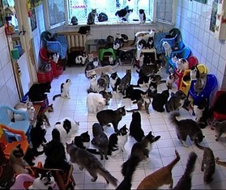
“Rescuer hoarder”
Largest group
Compulsion to “save lives”
Active and passive acquisition
Often have enablers
Vehemently oppose euthanasia
Notes:
http://www.psychiatrictimes.com/addiction/hoarding-animals-update/page/0/1

Slide 14
The Paradox of Animal Hoarding
“Animal hoarding … represents a form of severe maltreatment … characterized by a deep bond for the animals in conjunction with a profound lack of insight into their suffering and even death.”
Patronek & Nathanson in “Animal Maltreatment”, 2016
Notes:
Animal Maltreatment p160

Slide 15
DSM-5, 2013
“Animal hoarding may be a special manifestation of hoarding disorder.
“The most prominent differences between animal and object hoarding are the extent of unsanitary conditions and the poorer insight in animal hoarding.”

Slide 16
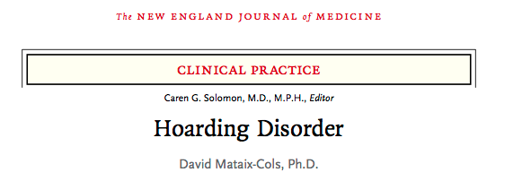
Do animal hoarders fit the criteria for Hoarding Disorder?
Yes.
Unclear.
Notes:
Refer viewers to these references, will not go into these in much depth – not my area and most on AH is anecdotal

Slide 17
Similarities | AH | OH
Excessive acquisition, cluttered and disorganized living spaces | ✔ | ✔
Difficulty discarding (giving up), distorted attachment | ✔ | ✔
History of traumatic life events | ✔ | ✔
Lack of insight | ✔ ✔ | ✔
Attribute human characteristics to objects or animals | ✔ | ✔
Distorted beliefs about responsibility | ✔ | ✔
Chronic course, recurrence common | ✔ | ✔

Slide 18
Differences | AH | OH
Frequent squalor | ✔ | ✖
Frequently only one type of item (species) | ✔ | ✖
Object hoarding | (30-80%?) | ✔
Onset at middle age or older | ✔ | ✖
Women over-represented | ✔ | ✖
Criminal prosecutions | ✔ | ✖
Harm to other living creatures | ✔ | ✖

Slide 19
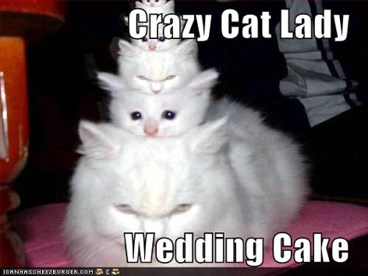
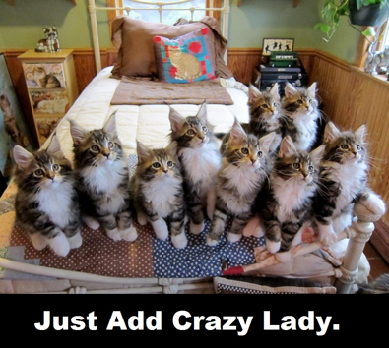
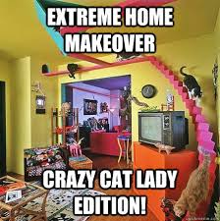
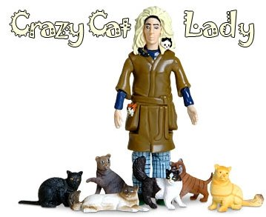
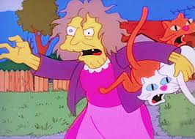
Trivialized and sensationalized

Slide 20
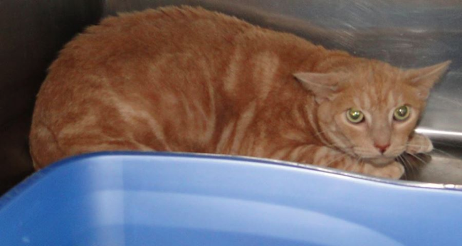
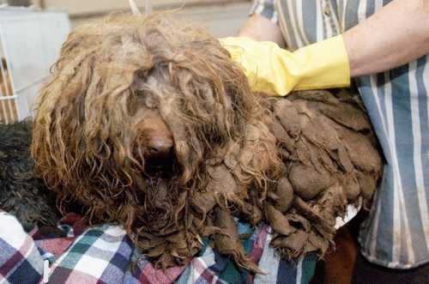
Animal Hoarding is a “malignant form of cruelty”
Compromised animal welfare is at the core of all hoarding cases
Can involve horrific suffering over a long period of time – both physical and emotional

Slide 21
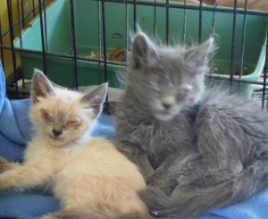
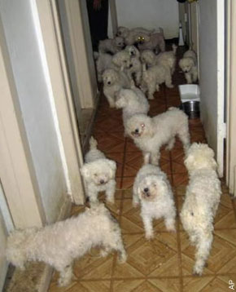
Animal suffering
Malnutrition, starvation
Filthy living conditions
Disease, injury and death
Abnormal social structures with no escape
Long-term confinement in crates or cages
Keeping feral cats captive

Slide 22
Human health & well-being
Health and safety issues – often dramatic
Unsanitary living environment (urine, feces, clutter)
Zoonotic diseases
Rodent and insect infestations
Homes unfit for habitation
Mental health
Severe self-neglect common, may be unable to carry out activities of daily living
Dependent individuals subject to neglect and abuse

Slide 23
Recognition – the Five Freedoms
Freedom from hunger and thirst
Freedom from discomfort
Freedom from pain, injury and disease
Freedom to express behaviours that promote well-being for that species
Freedom from fear and distress

Slide 24
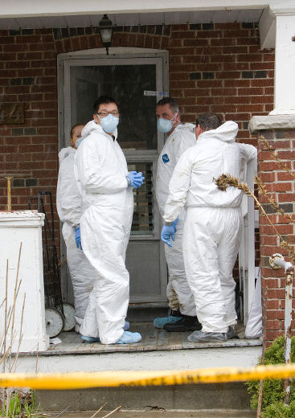
Traditional approach
Animal agencies seize and care for the animals…when things get bad enough and often after years of monitoring
Manor Road, Toronto, 2011
Beech Ave, Toronto, 2013

Slide 25
Ineffective and inhumane
Substantial suffering while animals wait for rescue
Health and safety of hoarder and dependents
Forcibly removing the animals traumatizes the hoarder (“like rape”)
Costs much higher – more damage, more agencies, legal costs of cruelty prosecution
Frustrating for surrounding community
~ 100% recurrence rate

Slide 26
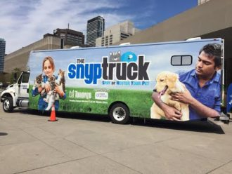
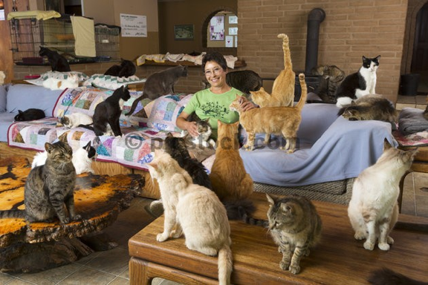
Harm reduction model
Identify problems early
Coordinated efforts
Provide counselling and animal care
Help them to keep and care for a smaller number of animals
Follow up
Notes:
https://www.animalalliance.ca/toronto-animal-services-snyp-truck/

Slide 27
Limits to harm reduction model
Client unable or unwilling to accept help
Animal suffering too severe allow gradual approach
Mental health resources not available

Slide 28
Mechanisms for intervention
Client accepts or asks for help – contact local shelter, rescue, SPCA
Client will not allow help –
Contact Animal Services / Animal Control
Contact OSPCA
City departments for other code violations

Slide 29
What can animal agencies and shelter veterinarians do?
Assess animal health and welfare
Assess capacity for care
Provide immediate care
Ongoing primary health care
Spay and neuter
Seizure of animals
Cruelty prosecutions

Slide 30
What do animal agencies need?
Mental health resources
Immediate help
Follow-up
Training for volunteers
Regulatory reform
Research

Slide 31
There are no treatment guidelines for animal hoarding
No established protocols
Build trust, reduce social isolation, focus on themes related to grief, loss, and attachment
Adapt approaches from object hoarding? Transferrable?

Slide 32
Key Sources
Animal Maltreatment: Forensic Mental Health Issues and Evaluations (2016) Levitt L, Patronek G, Grisso T
Hoarding of animals: an under-recognized public health problem in a difficult-to-study population. Patronek, Public Health Reports 114:81 (1999) [54 case reports]
Health implications of animal hoarding. Arluke et al, Health Soc Work 27:125 (2002) [71 case reports]
Hoarding of Animals Research Consortium (“Hoarding Central”
http://vet.tufts.edu/hoarding/
The Hoarding of Animals: An Update (2015)
http://www.psychiatrictimes.com/addiction/hoarding-animals-update Frost RO, Patronek G, Arluke A, Steketee G.

Slide 33
